Slide 1
Impacts of Datum Changes
on Nautical Charts
Travis Newman - NOAA
Mina Foroutan - CHS
1:30pm - 2:00pm
April 6, 2023

Slide 2
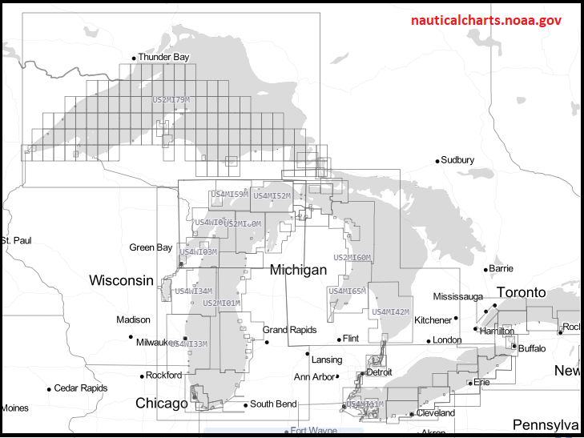
NOAA Great Lakes ENC Coverage
290+ ENCs
Rescheming effort underway
Gridded boundaries
Uniform scales
Foundation for S-101 production in 2026
Improved NOAA custom charts

Slide 3
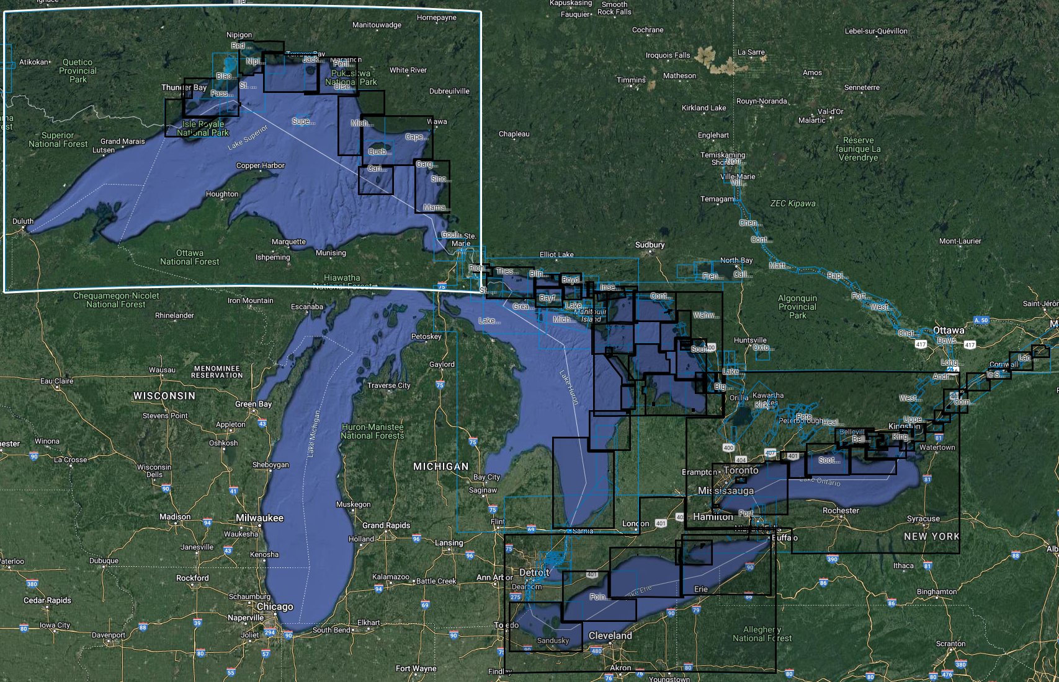
CHS Great Lakes & St. Lawrence Coverage
200+ products
ENC and paper products
CHS still have 22 products on IGLD55
Not all data has been loaded into the database
Rescheming effort underway
gridded boundaries
uniform scales

Slide 4
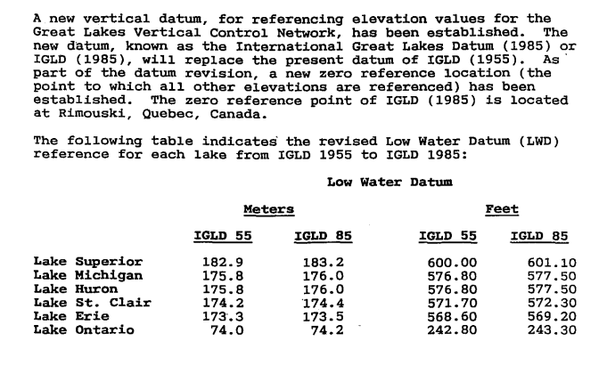
1985 Datum Update - NOAA approach
Notes were revised (1993)
Charted depths were not changed

Slide 5
1985 Datum Update - CHS Approach
Some IGLD55 products were updated to 85 via an NTM caution note
Other products were recompiled on the new IGLD85 datum as part of their normal life cycle maintenance

Slide 6
2020 IGLD Update Options
Leave products as is and release an NTM informing of a new datum note (new reference values)
Mariner will need to calculate values
Mathematically edit the values on the product - via global shift
Oddball contours
Recompile all affected charts!?!
Impossibility
Contemporary data not necessarily available for the Great Lakes
10-15 years to recompile for all products
Recompile the charts with the greatest effect
Recompile the charts in the most critical areas
Hybrid option
Leave products on IGLD85 and update as new areas are surveyed
New tools might provide avenue for efficient updates

Slide 7
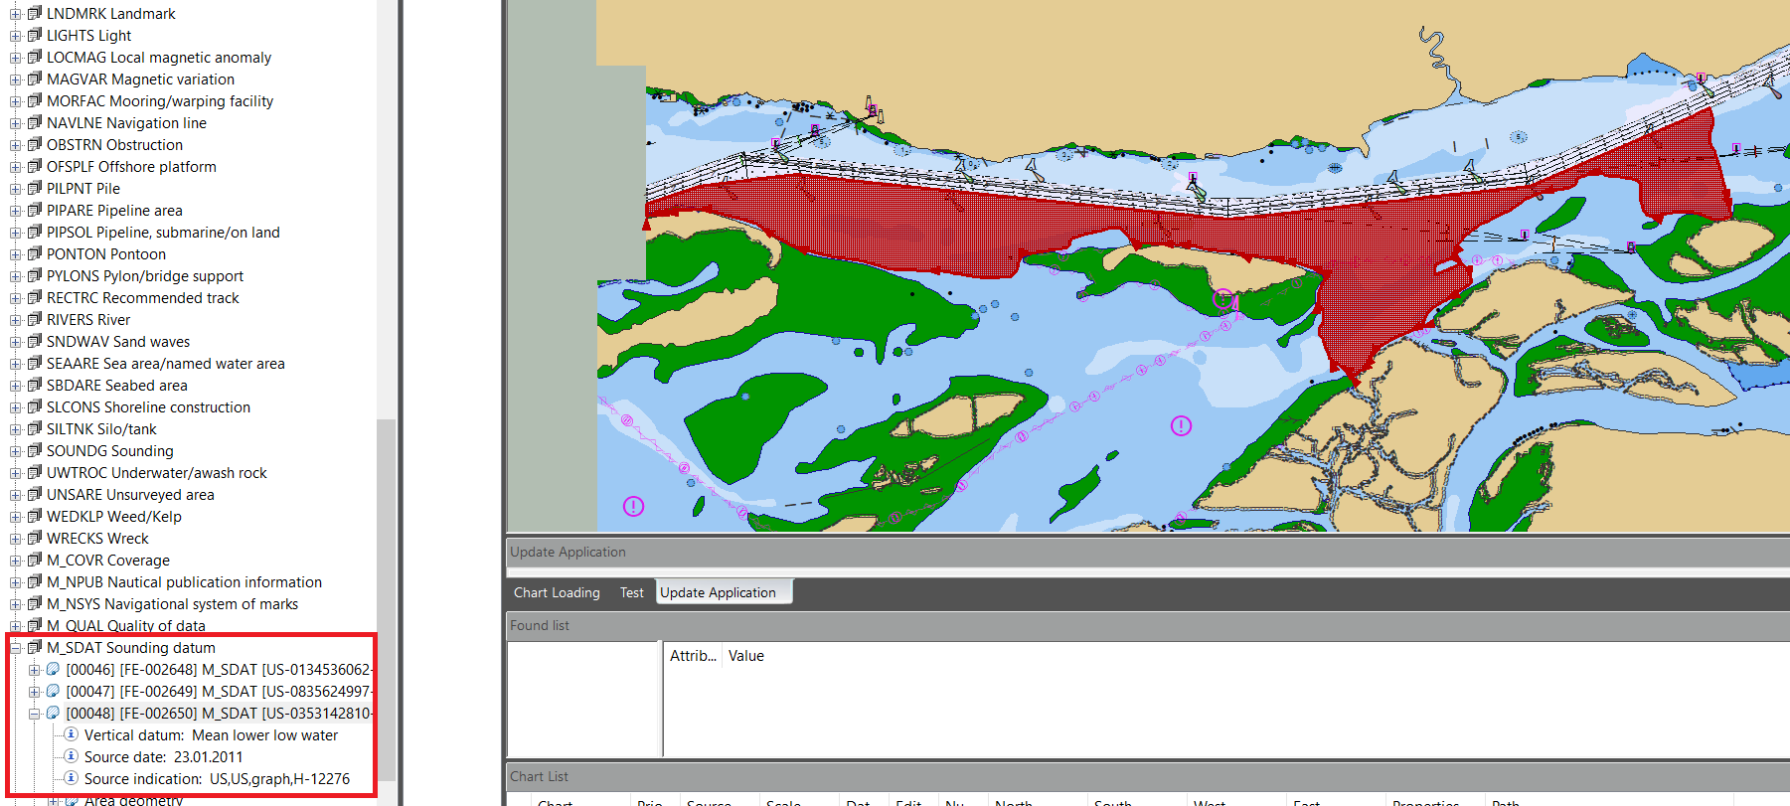
2020 IGLD Update Options
Example where new survey on a different datum than ENC
Columbia River Datum (Local Datum)
MLLW

Slide 8
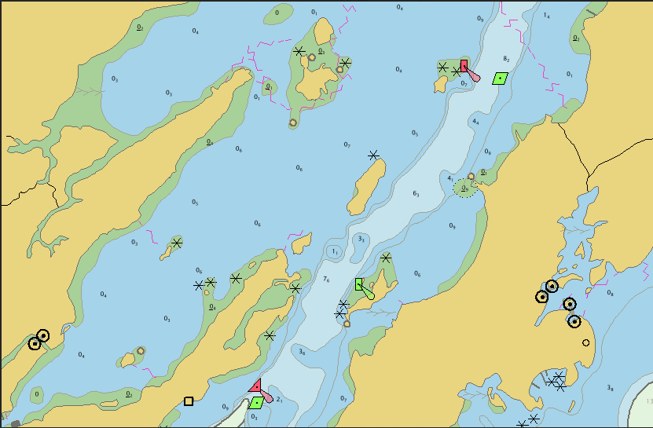
Database snapshot

Slide 9
2020 IGLD Update Effect
What chart producers need to know:
What type of effect will there be on the chart datum?
What is the order of magnitude?
Or, is it negligible?
What is the criticality of not updating the datum on the products?
Or, only adding the note?
What are the implications of having multiple datums on a product or in an area?
What is the risk of having a product line on three different datums?
What are the mariners’ expectations?

Slide 10
Questions?
Travis Newman - NOAA
Travis.Newman@noaa.gov
‪(304) 506-7955
Mina Foroutan - CHS
Mina.Foroutan@dfo-mpo.gc.ca
(905) 320-6302

