Slide 1
IGLD 2020: Water Level Data Collection
Sierra Davis and Khaleel Arfeen
April 6, 2023

Slide 2
Importance of Water Levels in IGLD
IGLD is the official vertical datum reference for water level measurements and navigation products through the Great Lakes, their connecting channels and the St. Lawrence River
Required for the unified, internationally coordinated collection, compilation and use of data for hydraulics, hydrology and water level management:
Marine navigation and transportation
Regulation of lake & river flow through connecting waterways
Nautical chart updates (CHS, NOAA)
Lake level forecasting
Coastal Zone Activities
The Great Lakes region is changing and the way we interact with these waters is also changing. We want to ensure the best product is available for our stakeholders.

Slide 3
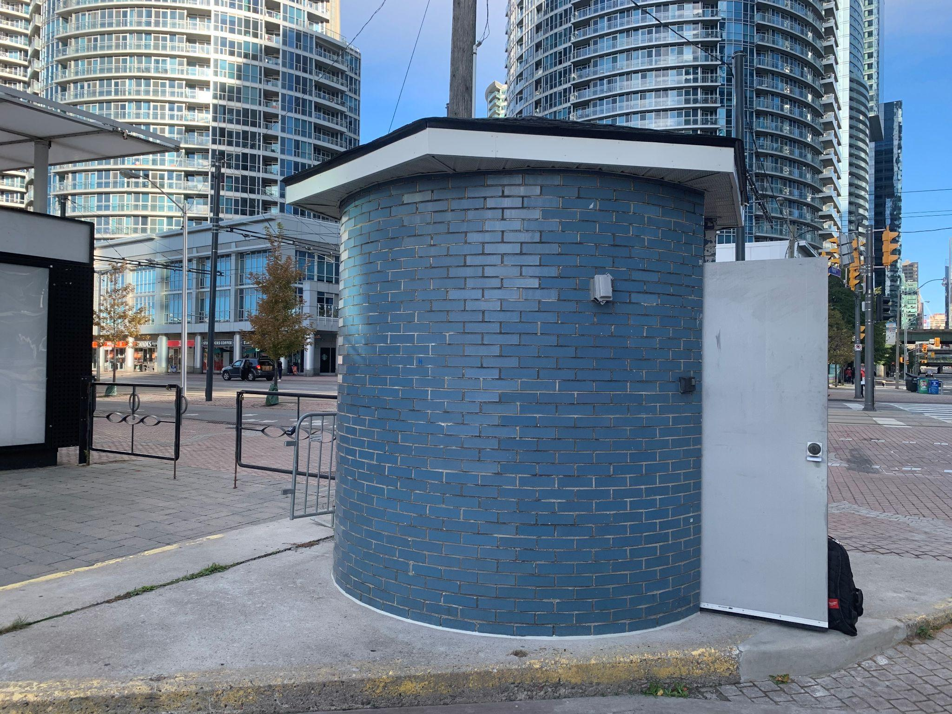
Great Lakes Water Level Gauging
Permanent Gauging – support daily operational mission
Permanent structures, year-round data collection
Few permanent gauges installed in recent years
Canada: 58 | United States: 53
13320 Toronto, ON
Seasonal Gauging – help to fill data gaps
Canada: 66 | United States: 54
Data collection through summer months (June - September)
Factors considered for selecting seasonal gauging locations:
Datum transformation and lake surface topography
Ports and coastal infrastructure
Storm preparedness
Proximity to bench mark locations
Spatial analysis
9034057 New Baltimore, MI (left), 11250 Killarney, ON (right)
Notes:
gaps in the existing network were identified based on three primary factors: station proximity to PC-02 nodal lines[SA1] (nodal points of seiches), variations in Hydraulic Corrector Contours, and pairing with NOAA stations falling along similar hydraulic contours and nodal lines.
Additional criteria that were taken into consideration include proximity to an area with relatively large vertical motion, high priority commercial ports and high priority recreational ports/harbours of refuge. Criteria also considered were factors such as proximity to high population areas, nuclear and hydroelectric power plants, existing infrastructure (e.g., docks, piers), as well as proximity to Canadian Coast Guard/National Geodetic Survey benchmarks [SA2] – for ties between the original IGLD and updates[SA3] .

Slide 4
Water Level Station Uses

Slide 5
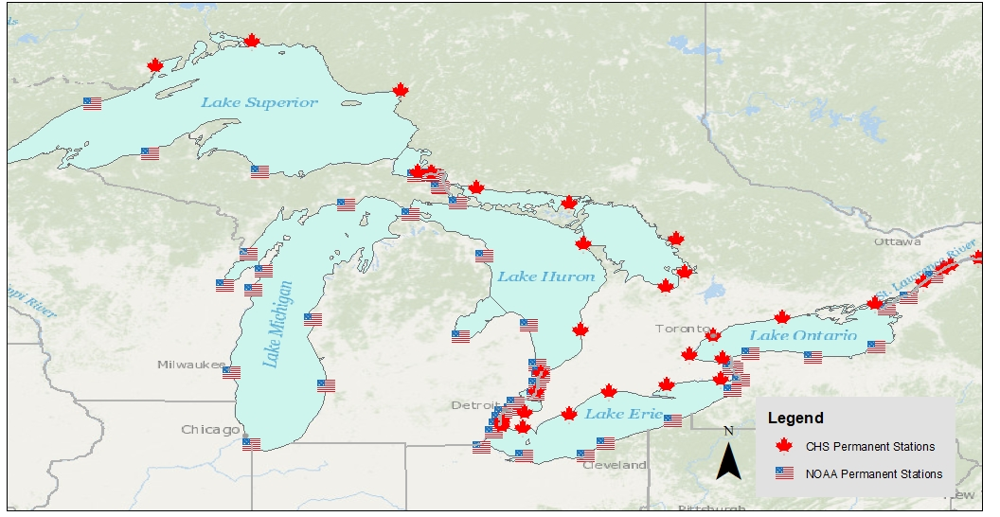
Bi-national Water Level Coordination

Slide 6
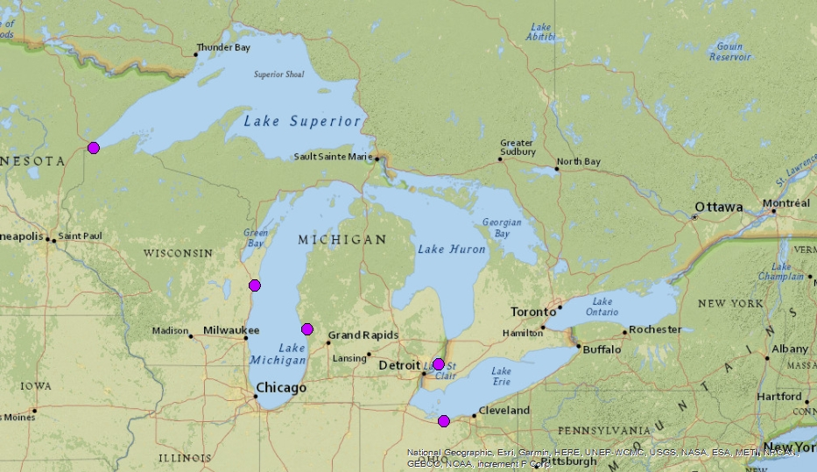
IGLD (2020) Seasonal Stations By Year - 2014

Slide 7
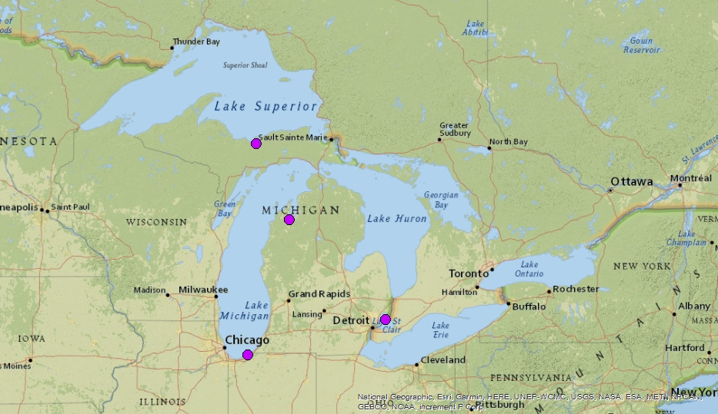
IGLD (2020) Seasonal Stations By Year - 2015

Slide 8
IGLD (2020) Seasonal Stations By Year - 2016

Slide 9
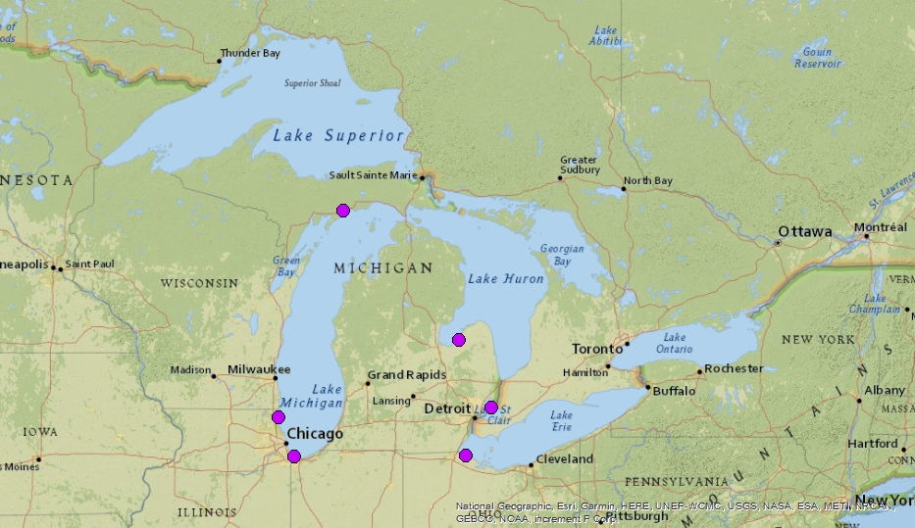
IGLD (2020) Seasonal Stations By Year - 2017

Slide 10
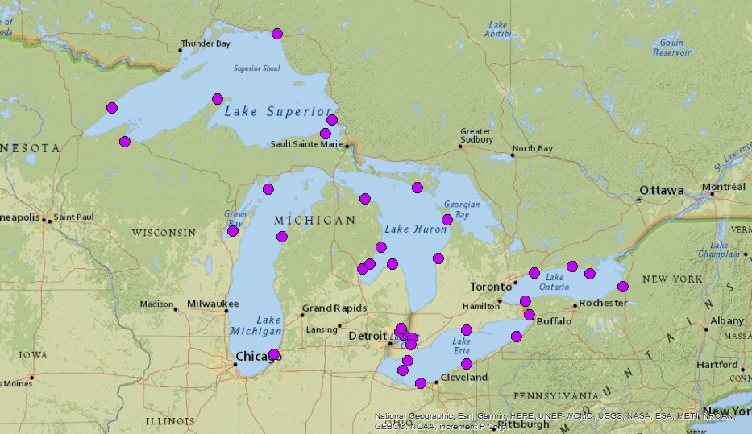
IGLD (2020) Seasonal Stations By Year - 2018

Slide 11
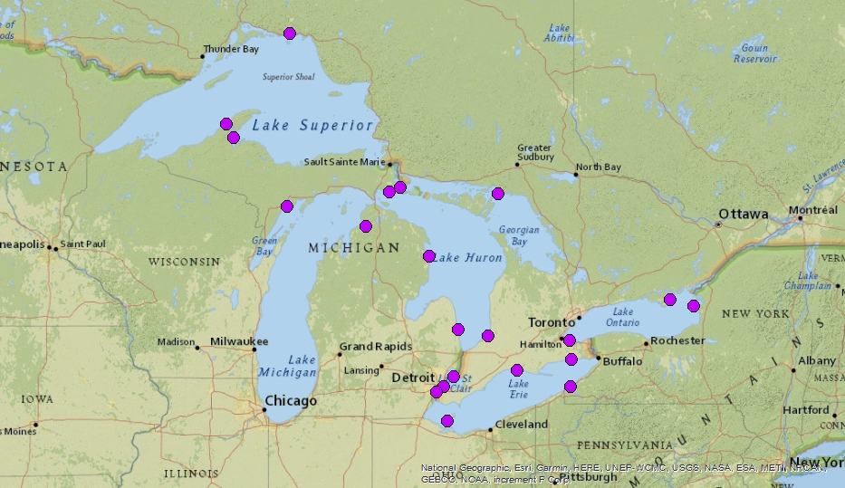
IGLD (2020) Seasonal Stations By Year - 2019

Slide 12
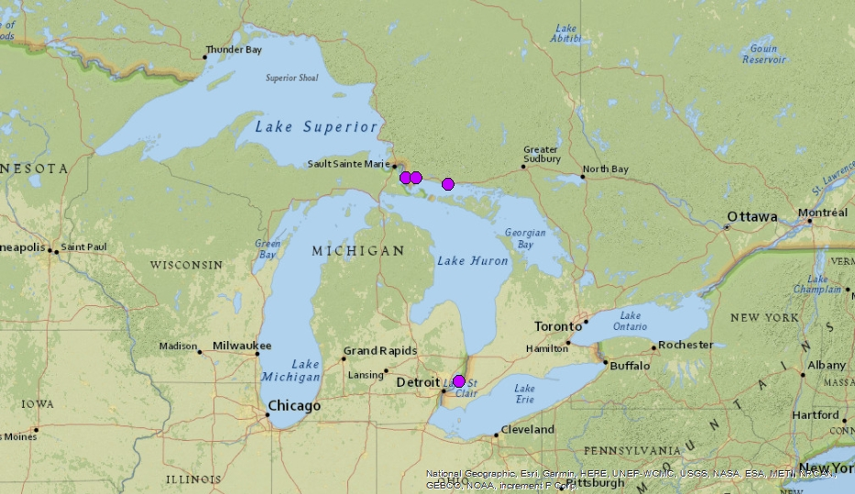
IGLD (2020) Seasonal Stations By Year - 2020

Slide 13
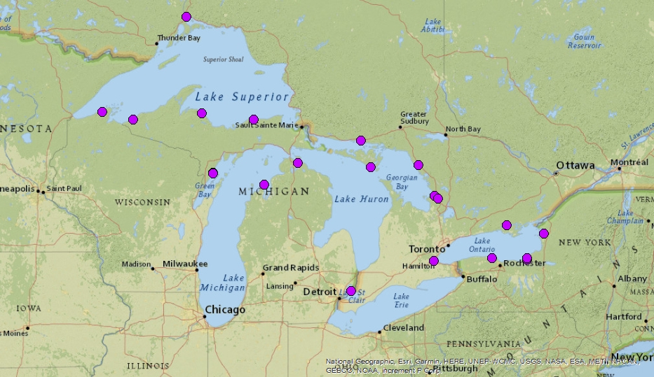
IGLD (2020) Seasonal Stations By Year - 2021

Slide 14
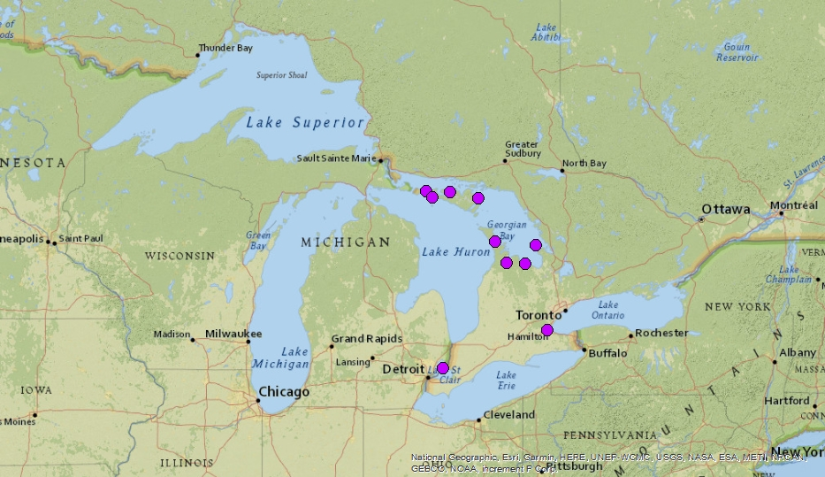
IGLD (2020) Seasonal Stations By Year - 2022

Slide 15
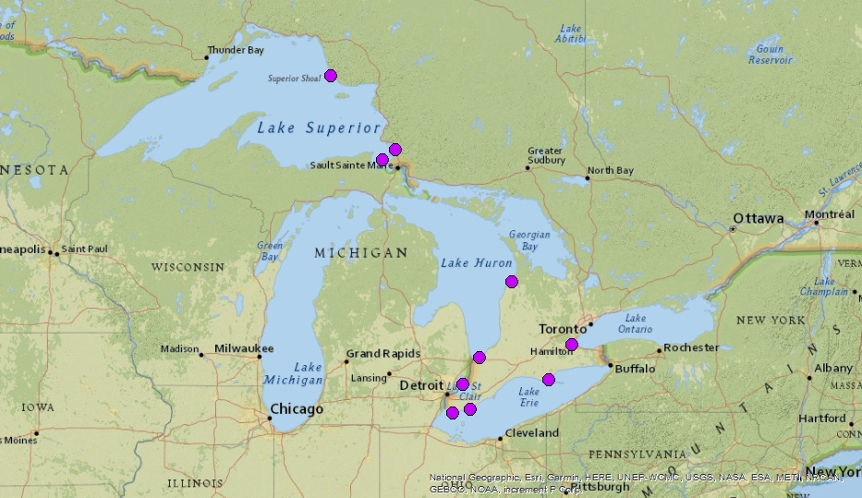
IGLD (2020) Seasonal Stations By Year - 2023

Slide 16
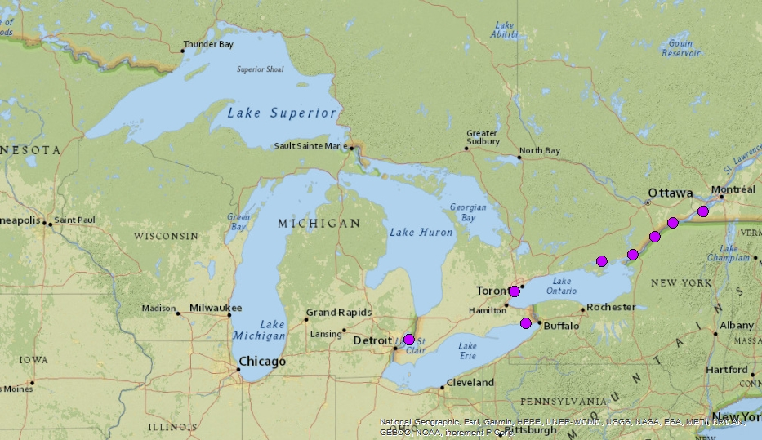
IGLD (2020) Seasonal Stations By Year - 2024
Notes:
Just mention that CHS 2024 is tentative (focus on st. lawrence)

Slide 17
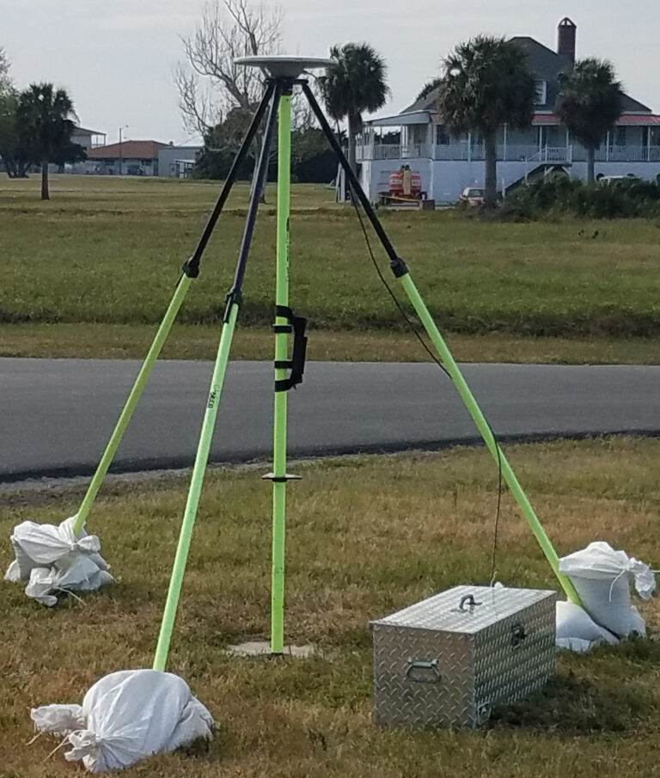
New Technologies for IGLD (2020)
Global Navigation Satellite Systems (GNSS)
Field Campaigns - seasonal and permanent WL stations
NOAA Continuously Operating Reference Stations (CORS)
NRCAN Canadian Active Control Systems (CACS)
Updated Spatial Reference Systems
NATRF2022, NAPGD2022/CGVD2013, GEOID2022
Data transmission, automated processing, datum determinations and transformations
Water level station hardware
Use of Microwave Radar Water Level Sensors
GOES satellite data transmission
Station upgrades and new station installations
GNSS Field Occupation
MWWL Sensor

Slide 18
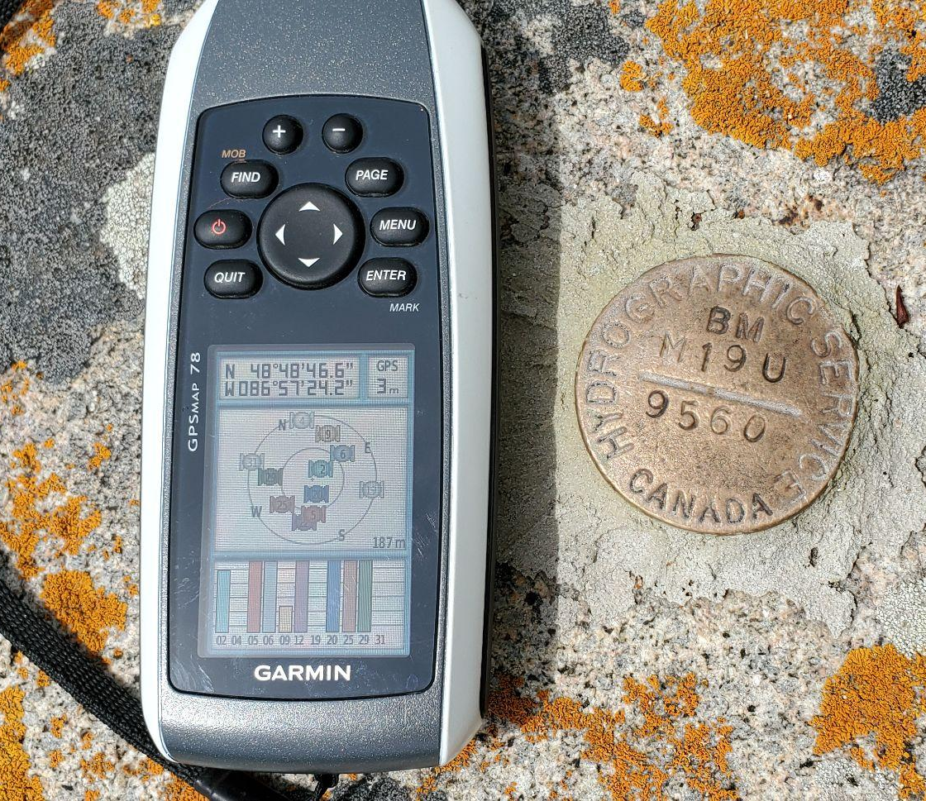
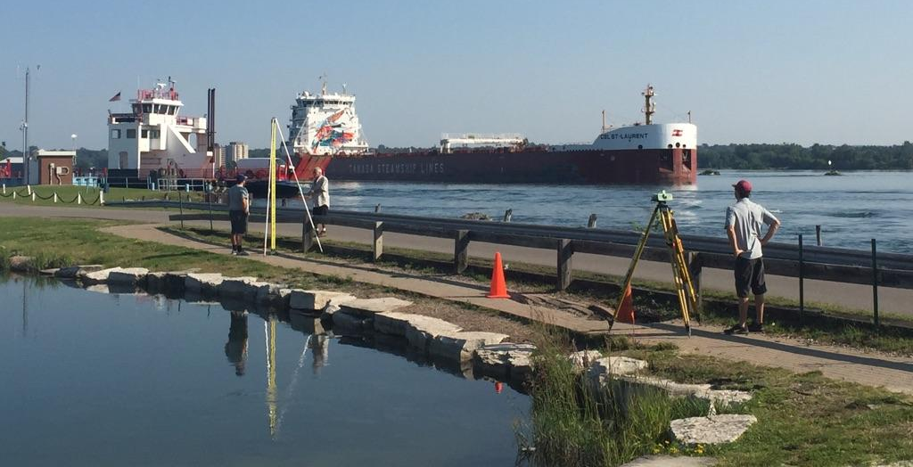
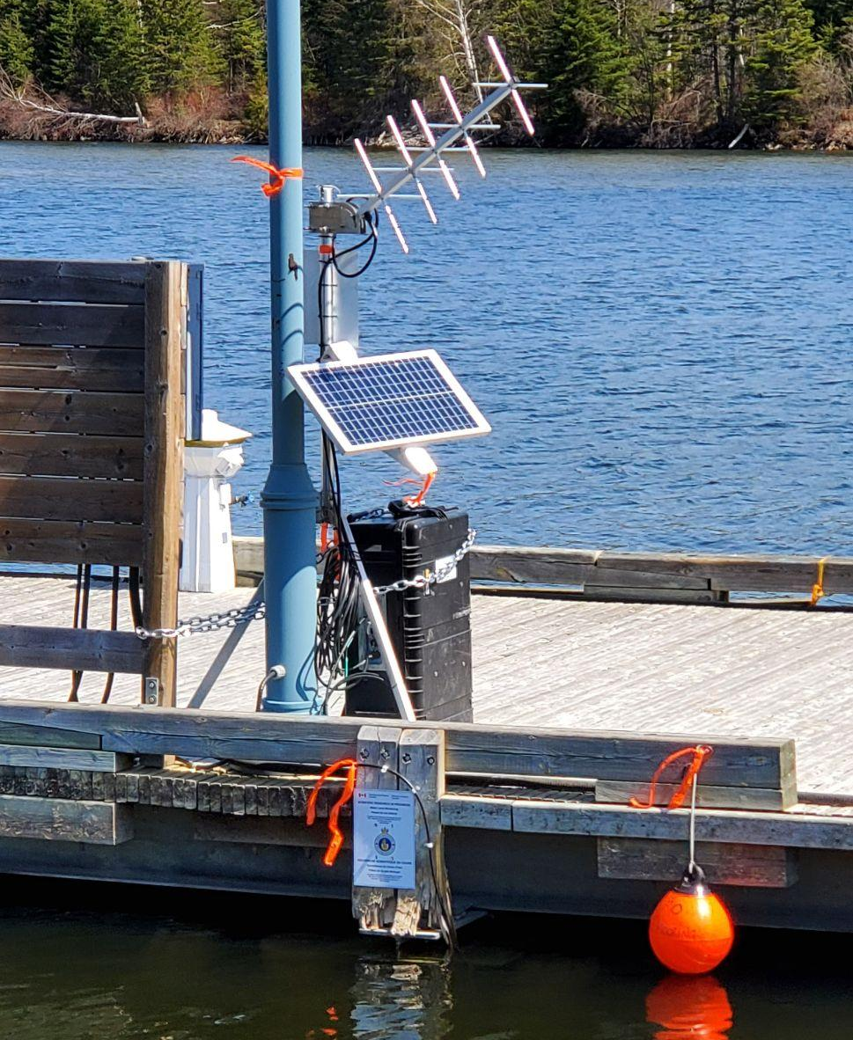
Leveling/GNSS Ties IGLD (2020) to the Modernized NSRS
Ensures sensor stability throughout water level data collection
Allows connection of geodetic datums to water levels (dynamic heights)
NAPGD2022 - upcoming new, unified (US/Canada) vertical geodetic datum; requires both leveling and GNSS occupation at bench marks
Handheld GPS - Positioning of BM
GNSS Campaign Collection
Leveling Survey Campaign at Little Rapids, St. Marys River - 2017
Seasonal Gauging Site in Canada
Notes:
9076033 Little Rapids in 2017 (St mary’s river)

Slide 19
Data Product Coordination and Dissemination

Slide 20
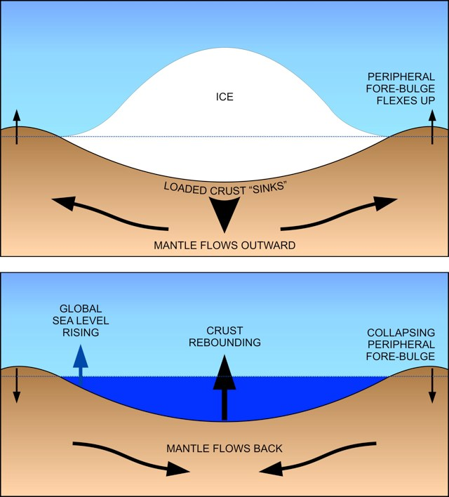
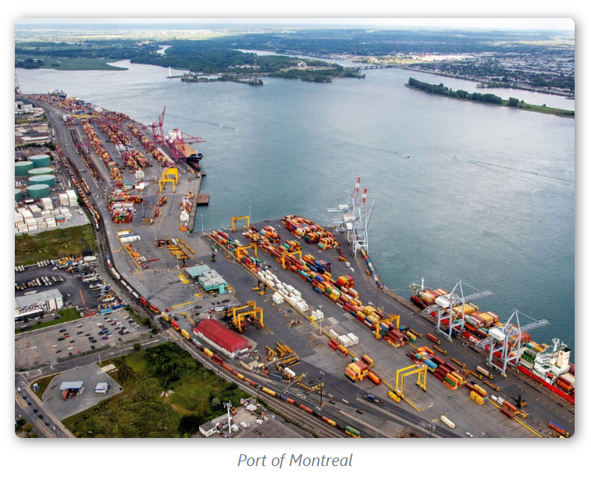
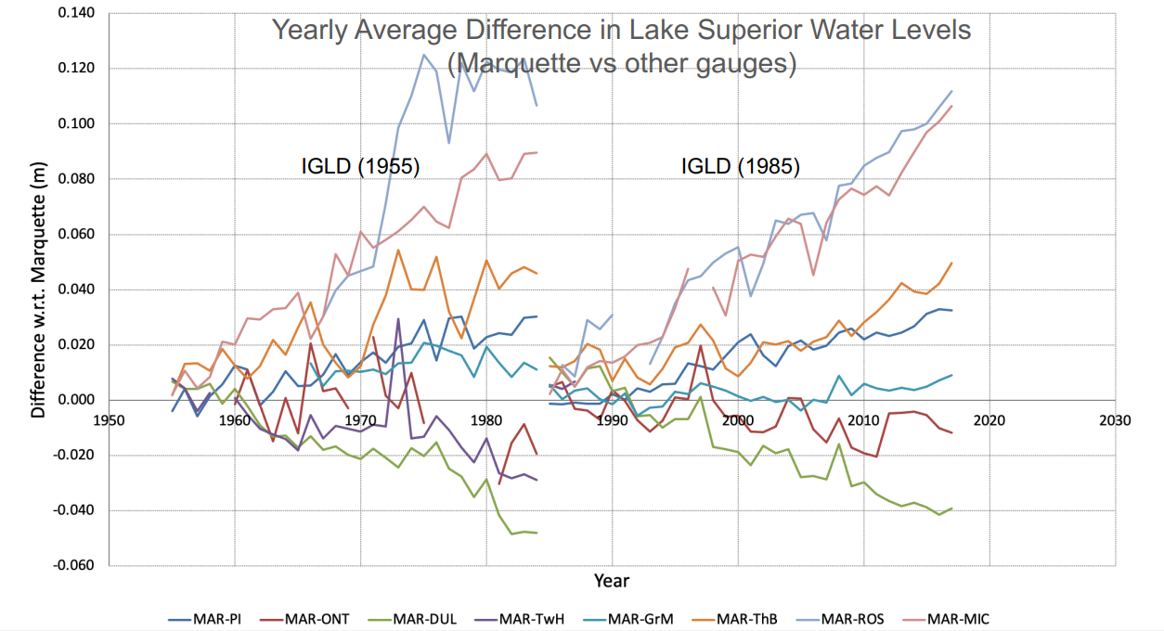
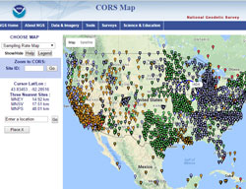
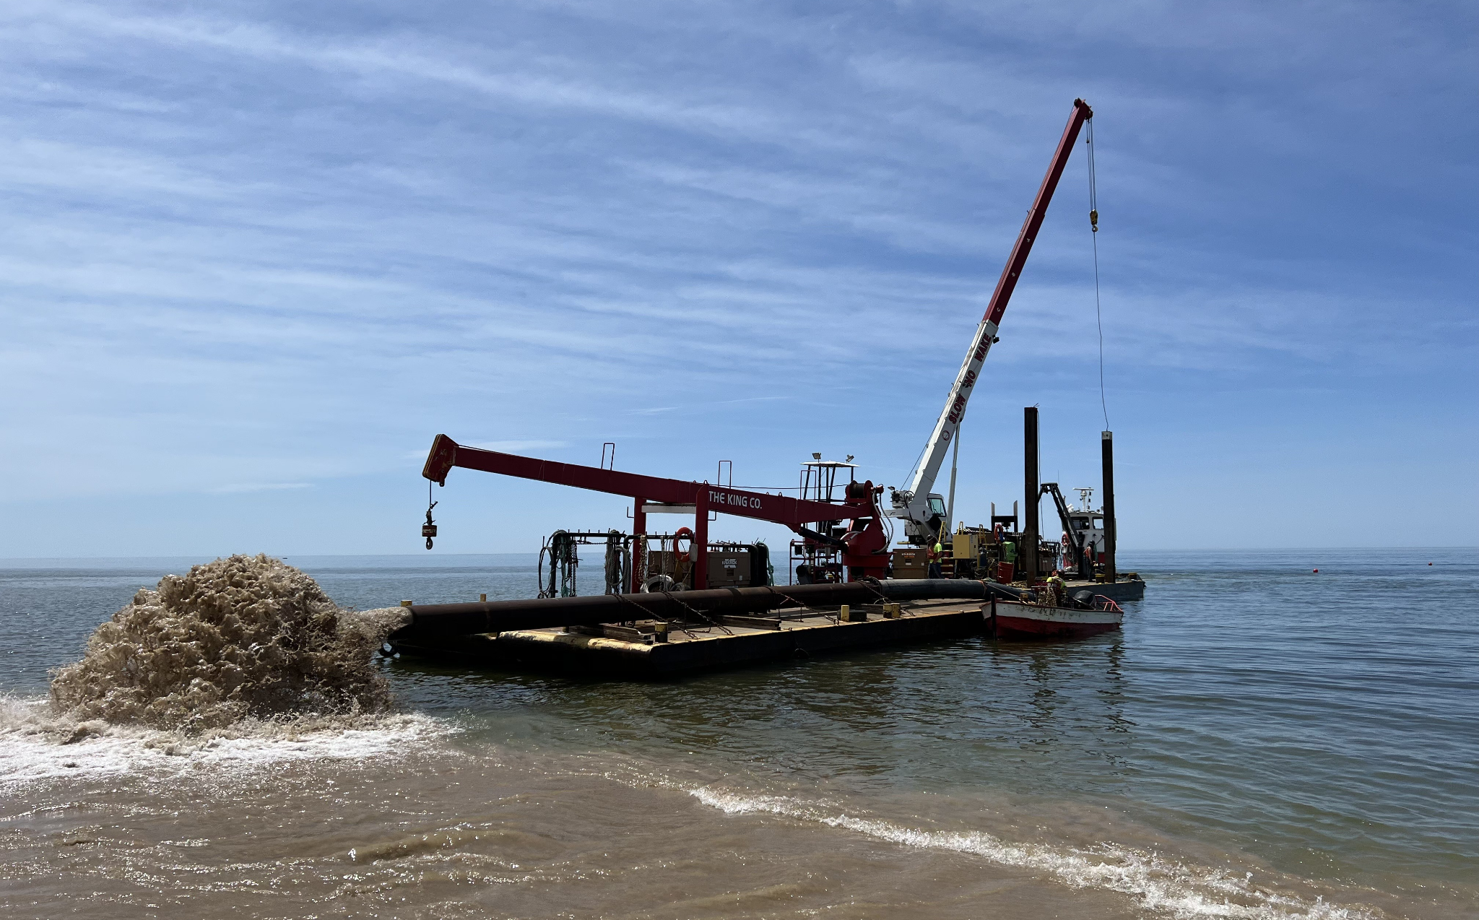
Lake Levels will Determine IGLD (2020)
Port of Montréal
The general process of GIA. Top: Heavy ice loads Earth’s surface. Bottom: Once the ice is removed, some areas rebound, while others collapse.
Photo: USACE ; U.S. Army Corps of Engineers contractor, The King Co., Inc. conducts maintenance dredging at Holland Harbor in Michigan May 2022. Photo by: Emily Schaefer
Notes:
Lake Levels will Determine IGLD (2020)
First title: Why update lake-wide mean water levels now?
WL change over 30+ years…
Impacts of GIA
Weather and climate changes over time ((precipitation - from recent presentation)) ((Seiche event))
New infrastructure, land use changes ((hydro plants // locks // Montreal port update?))
Hydro energy uses
Dredging ((stock))
Utilize new technology
Updated lake-wide reference
New zero reference for lake-wide mean
New Hydraulic Correctors

Slide 21
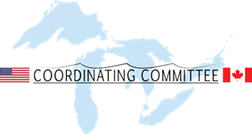
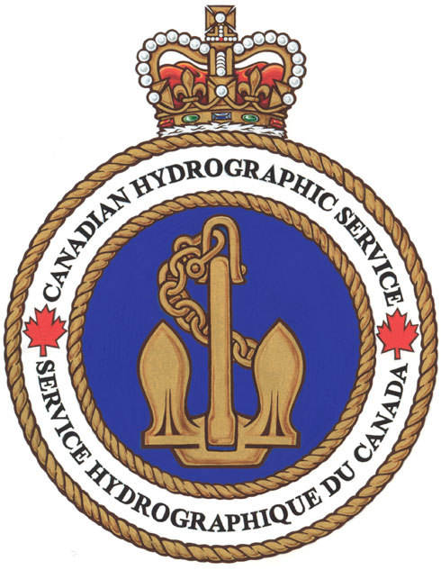
Further Information
IGLD Update:
Coordinating Committee: https://www.greatlakescc.org/
NOAA IGLD Update webpage: https://tidesandcurrents.noaa.gov/datum-updates/igld/
Geodetic Data:
NRCAN: https://www.nrcan.gc.ca/maps-tools-and-publications/geodetic-reference-systems/data/10923
NOAA NGS: https://geodesy.noaa.gov/INFO/gnss-gps-data.shtml
Water Level Data:
CHS: https://tides.gc.ca/en/tides-and-water-levels-data-archive
NOAA CO-OPS: https://tidesandcurrents.noaa.gov/stations.html?type=Water+Levels

Slide 22
Questions?

