Slide 1
Overview of IGLD
Jacob Heck National Geodetic Survey, NOAA
Michael Craymer Canadian Geodetic Survey, Natural Resources Canada
Notes:
30 minutes, 9:15 - 9:45 am

Slide 2
Datum Fundamentals
Find the height of a point

Slide 3
Datum Fundamentals
Find the height of a point
4
3
2
Height = 3
1
Datum A = 0

Slide 4
Datum Fundamentals
Find the height of a point
Same point (same position in space) but reference to a different datum
3
2
1
Height relative to Datum B = 2
Datum B = 0
Datum A = 0

Slide 5
Different Types of Datums
MWL
Height above LWD
BM
LWD (Chart Datum)
H^{D} of BM
Height of LWD above fundamental vertical datum
Water height above fundamental vertical datum
Fundamental vertical datum (IGLD)
Notes:
All these other datums need to be referenced to a fundamental vertical datum

Slide 6
The International Great Lakes Datum
International Great Lakes Datum (IGLD) is a common height reference system by which water levels can be measured and meaningfully related to each other
Official vertical datum used for water level measurements and navigation charts throughout the Great Lakes, their connecting channels and the upper St. Lawrence River
Maintained by the Coordinating Committee on Great Lakes Basic Hydraulic and Hydrologic Data, a binational committee with representatives from the Governments of Canada and the United States
IGLD is updated every 25-35 years due to Glacial Isostatic Adjustment (GIA)
The next update will be IGLD (2020)

Slide 7
Coordinating Committee on Great Lakes Basic Hydraulic and Hydrologic Data
Formed in 1953
Ad hoc group of federal experts
Four subcommittees
Hydraulics
Hydrology
Coordinated Regulation and Routing Model
Vertical Control - Water Levels
Update and revise IGLD
Standardize water level data processing

Slide 8
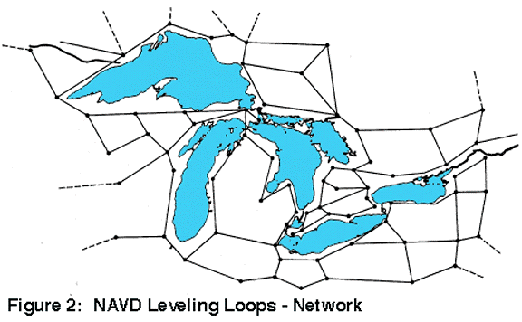
Current IGLD
IGLD (1985) replaced IGLD (1955) in 1992
Same reference zero as NAVD 88 (tide gauge at Pointe au Père, Québec)
Surface determined from leveling
Very time consuming & cost prohibitive
Datum accessible only where leveling exists (benchmarks)
Susceptible to accumulation of systematic errors
Uses dynamic heights
Hydraulic correctors applied to water levels of the lakes
Notes:
Great Lakes Vertical Datums: Dynamic Heights Local > MSL 1877 > USLS 1903 > USLS 1935 > IGLD 1955 > IGLD 1985 > IGLD2020
Prior to IGLD 55, the countries were using different datums

Slide 9
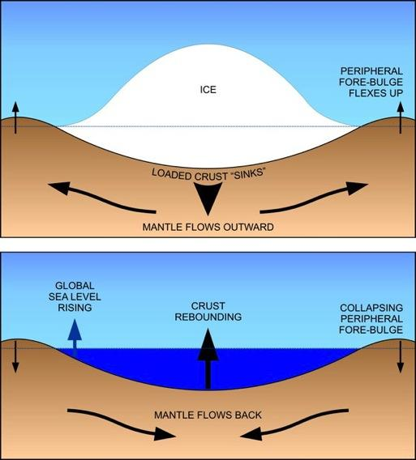
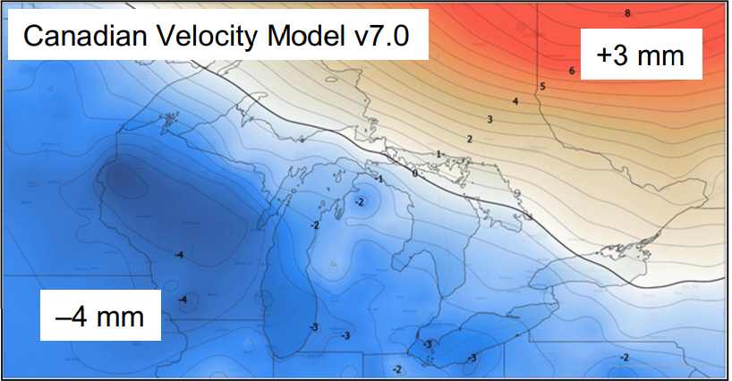
Why a new IGLD?
Glacial Isostatic Adjustment – (GIA)
Uplifting in north
Subsiding in south
Overall tilting ~7 mm/year (21cm or 0.7’ over 30 year)
Need to update IGLD every 25-30 years
Contour map of vertical velocities in mm/yr
Process of glacial isostatic adjustment

Slide 10
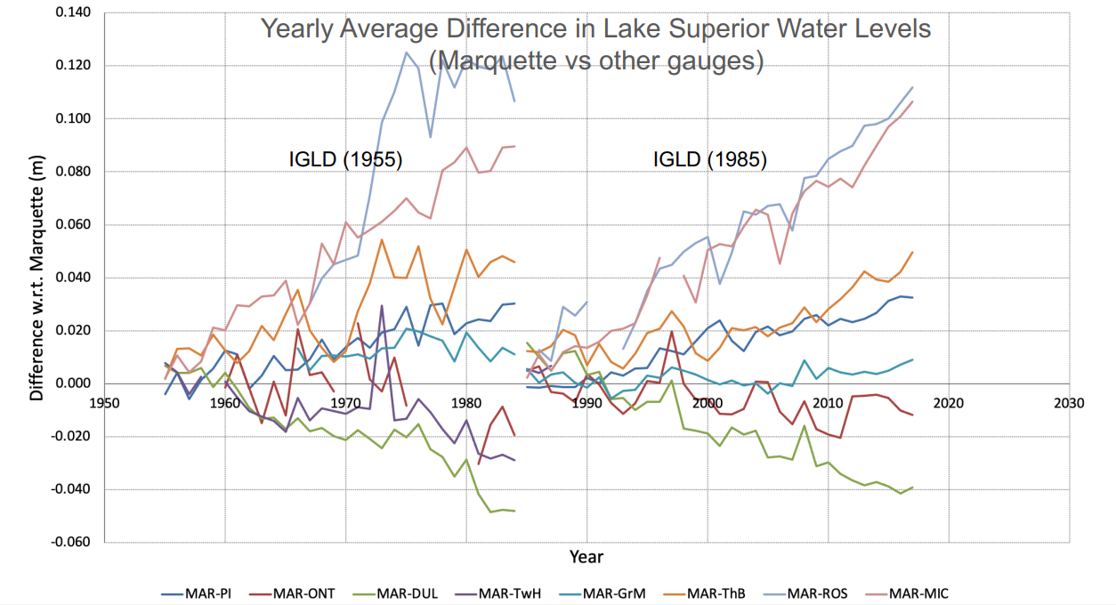
Effect of GIA Tilting on Water Levels

Slide 11
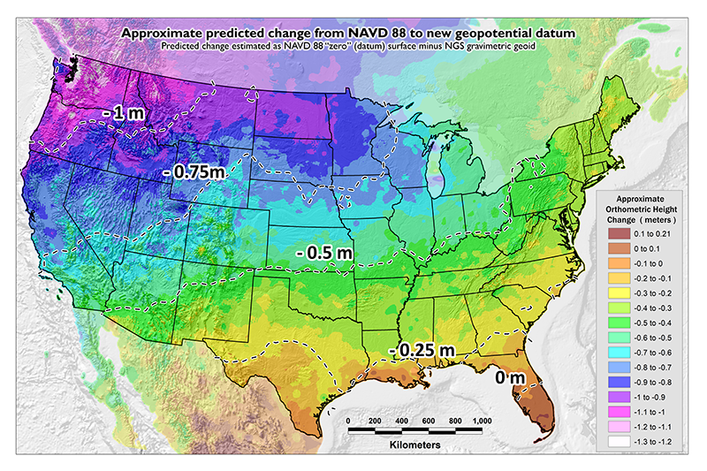
North American-Pacific Geopotential Datum of 2022
NAVD 88 is being replaced by NAPGD2022 (expected 2025)
Based on a geoid model
Geoid defined by gravity data
Not dependent on expensive leveling
Defined everywhere
Height determined via GNSS (more efficient) and references to the NATRF2022 ellipsoid
Local leveling will still be needed
Time-dependent
Coordinates will keep up with physical changes
Compatible with CGVD2013
Using identical reference zero
Canada expected to adopt the new geoid model
Will harmonize national vertical datums for IJC’s International Watersheds Initiative
IGLD (2020) will be based on NAPGD2022

Slide 12
North American Terrestrial Reference Frame of 2022
NAD 83 being replaced by North American Terrestrial Reference Frame of 2022 (NATRF2022)
Following international standards (ISO)
Geocentric – will be based on the new ITRF2020
Accurately fixed to the North American tectonic plate
Time-dependent
Coordinates will change with time due to intra-plate crustal motions (such as GIA)
Velocities will be available for CACS/CORS stations
Velocity model (grid) will be available for other stations
Reference epoch
Initially 2020.0
Plan to update to a newer epoch every 5 to 10 years
Will be a horizontal shift from NAD83 of up to 1.5 m
Ellipsoidal heights will be computed in NATRF2022

Slide 13
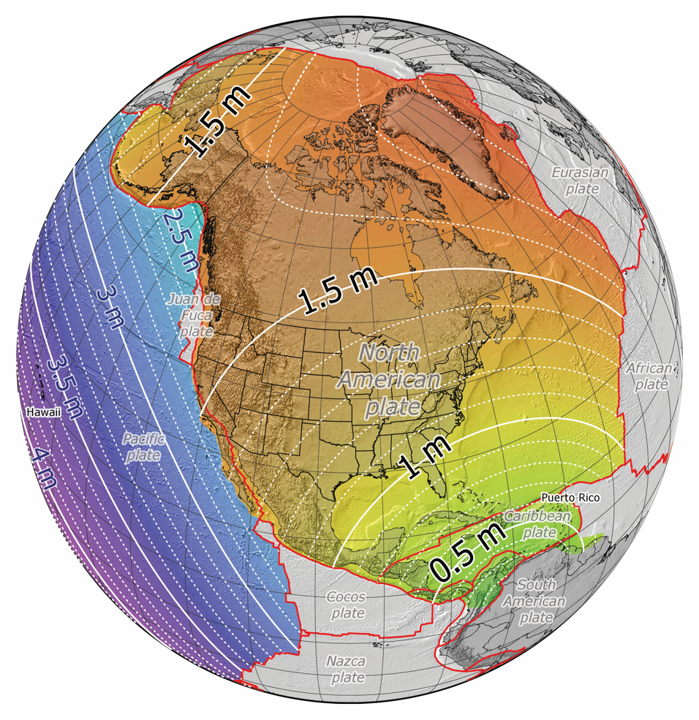
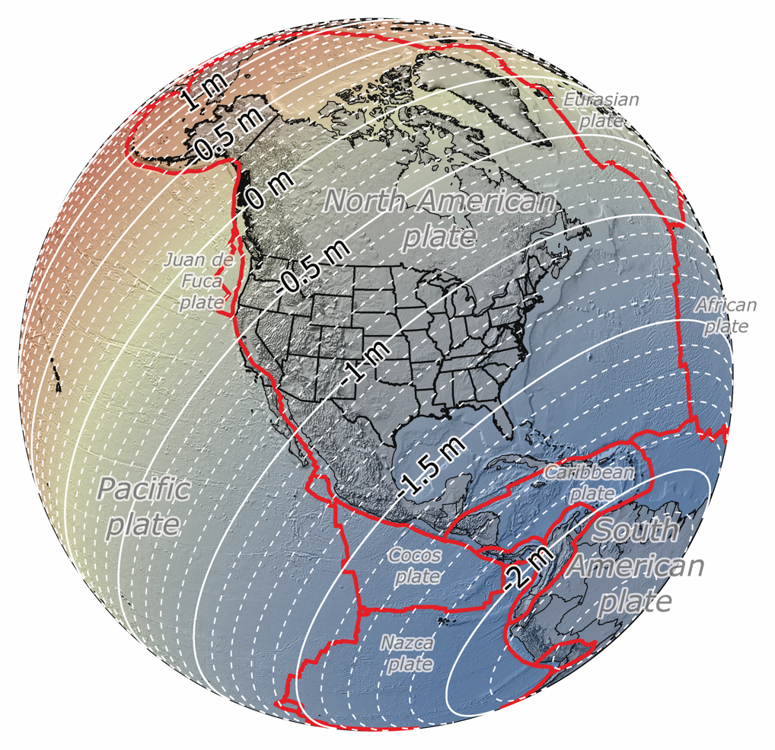
NATRF2022 vs NAD 83
Horizontal Change
Ellipsoidal Height Change
0 m
2 m
-2 m
2 m
1.3–1.5 m along border
0.3–1.2 m along border

Slide 14
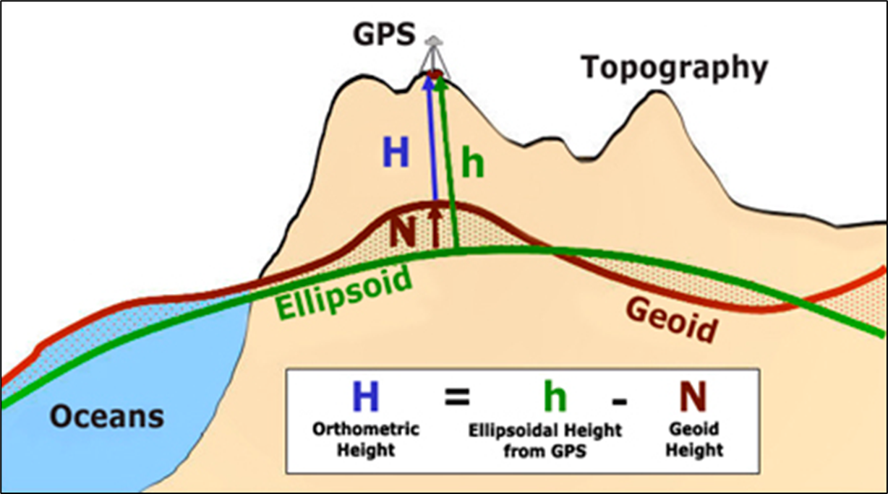
Heights from GNSS
IGLD (2020) heights determined via GNSS
Accurate & efficient
h & N must be referenced to the same reference ellipsoid (NATRF2022)
Dynamic heights are derived from H using a gravity model (grid)

Slide 15
IGLD (2020) Defining Attributes
Reference Zero
The basis for all heights in the system
Usually some determination of mean sea level
Reference Surface
How height above that reference zero is represented inland
Reference Epoch
A common time epoch for referencing heights and water levels
Dynamic Height
A quantity that provides a measure of hydraulic head
Hydraulic Correctors
Account for variations in water level across a lake

Slide 16
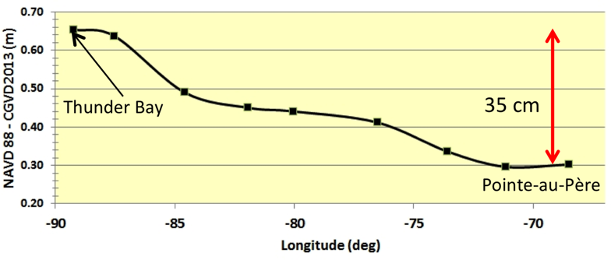
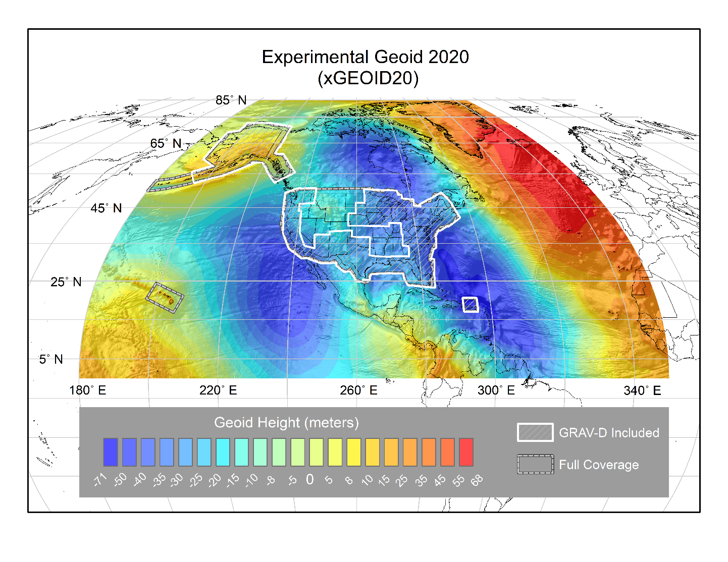
IGLD (2020) Attributes (continued)
Expected IGLD (1985) - IGLD (2020)
Reference Zero
Mean sea level around the coast of North America represented by a “geopotential value” of that surface
Same value as geoid-based North American-Pacific Geopotential Datum of 2022 (NAPGD2022)
Same value as geoid-based Canadian Geodetic Vertical Datum of 2013 (CGVD2013)
Reference Surface
NAPGD2022 geoid model representing the reference zero
Defined everywhere over the Great Lakes – St. Lawrence River system, not only where leveling and bench marks exist
Reference Epoch
2020.0 is the reference epoch for the heights
Same as the central epoch of the 7-year water level observation period of 2017–2023

Slide 17
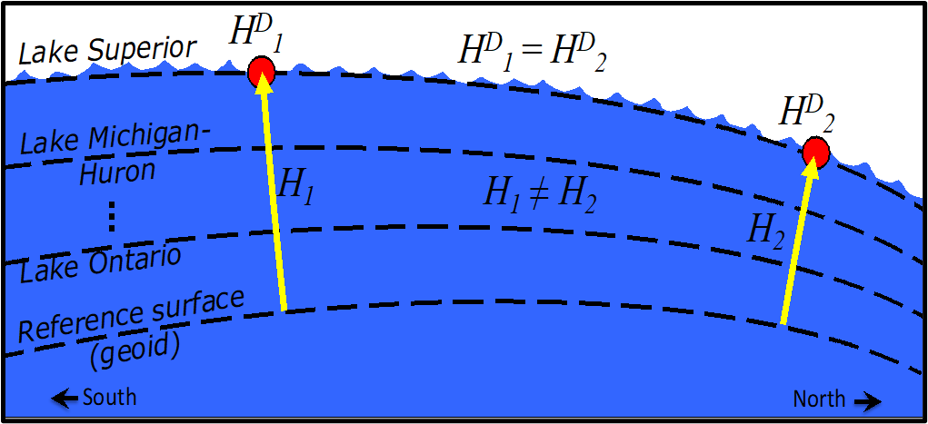
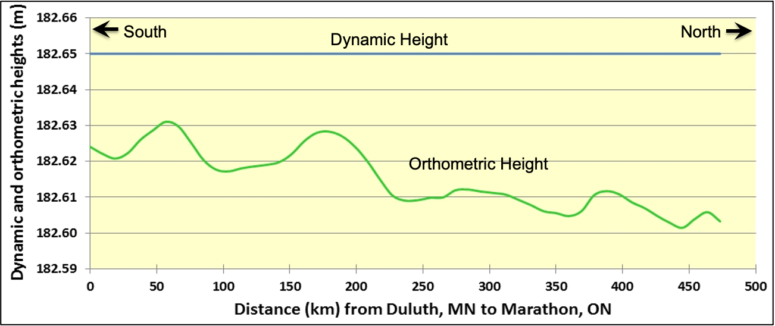
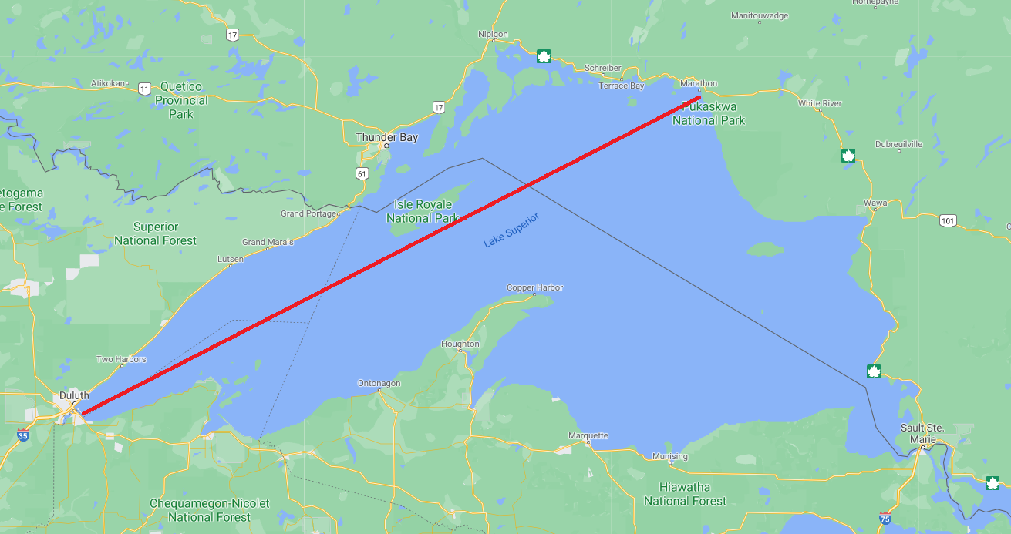
Dynamic Heights
Orthometric heights (H)
Typical heights used in most applications
Physical distance above reference surface (geoid)
Not constant along a level surface (like a lake) because equipotential convergence as you go north
Geopotential numbers scaled by local gravity
Dynamic heights (H^{D})
Geopotential numbers scaled by a constant gravity value
Constant along a level (lake) surface by definition
Enables the measurement of hydraulic head for water level Management
Used by all IGLD realizations
Dynamic heights, H^{D}, and orthometric heights, H.

Slide 18
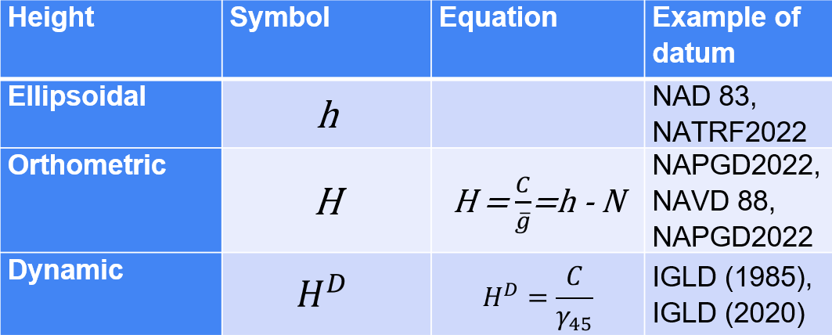
Types of Heights

Slide 19
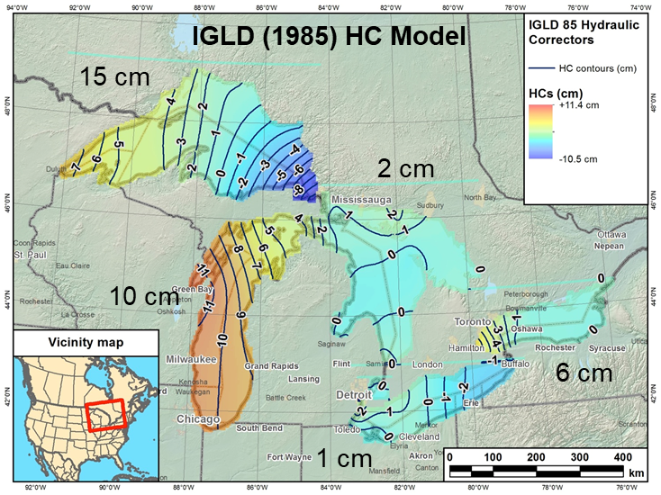
Hydraulic Correctors
Dynamic heights should be the same at all gauges on a level lake
In reality this is not the case because of
Currents, river discharge, temperature/density variations, prevailing winds, outlet drawdown
Creates a lake surface “topography”
Hydraulic correctors (HCs) adjust the dynamic height at each gauge to agree with a single “master” gauge on each lake
Used only for heights of water levels
IGLD (1985) HCs actually represent leveling errors
IGLD (2020) HCs should represent actual lake surface topography
Presently analyzing HCs for IGLD (2020)
May not be needed if small
Seasonal gauging being used to fill in the permanent network to provide a more accurate HC model

Slide 20
Status of IGLD Update
GNSS field campaign took place in 2022 – data processing continues (used for realizing IGLD (2020) at the water level gauge
Seasonal gauging continues
Hydraulic corrector working group is investigating the role of HCs in IGLD (2020)
IGLD (2020) is planned for release about one year after the release of the NAPGD2022 vertical datum (around 2026)

Slide 21
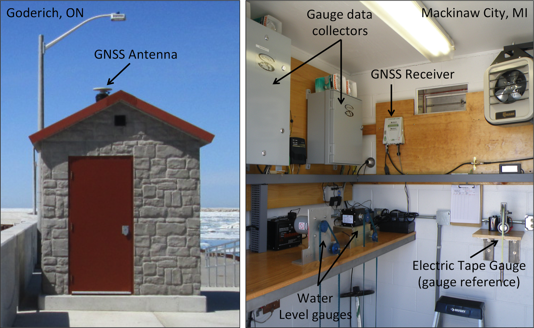
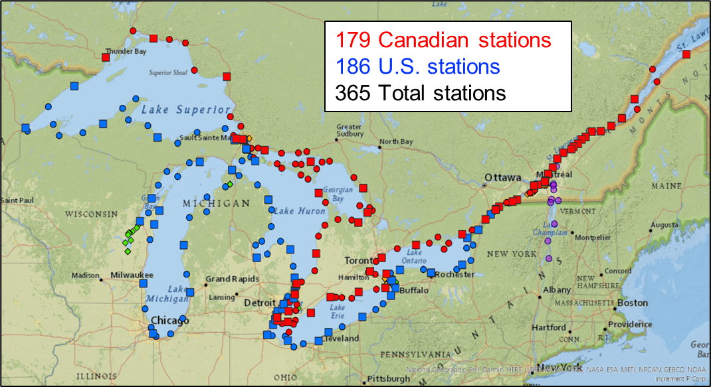
Water Level Stations
Permanent stations
CHS
NOAA
USACE
ECCC
USGS
Seaway (Canada & U.S.)
NYPA
OPG
Some with continuous GPS/GNSS
Seasonal gauges
Occupied bench marks at all gauges with GNSS in 2022
Notes:
Permanent GNSS stations (CORS 17 & CACS 14) installed at many key water level stations
[CORS - Continuously Operating Reference Stations Network]
[CACS – Canadian Active Control System]
Most Connected to same structure as the gauge reference
Enables
Accurate determination of absolute height of gauge reference and water level
No bench mark network needed if GNSS antenna reference point accurately tied to gauge reference – cost savings
Determination of crustal motion at water level stations for velocity model
Accurate velocity model allows datum to be used for longer period of time by accounting for crustal motion
Existing CORS & CACS need to be maintained & further expansion is recommended

Slide 22
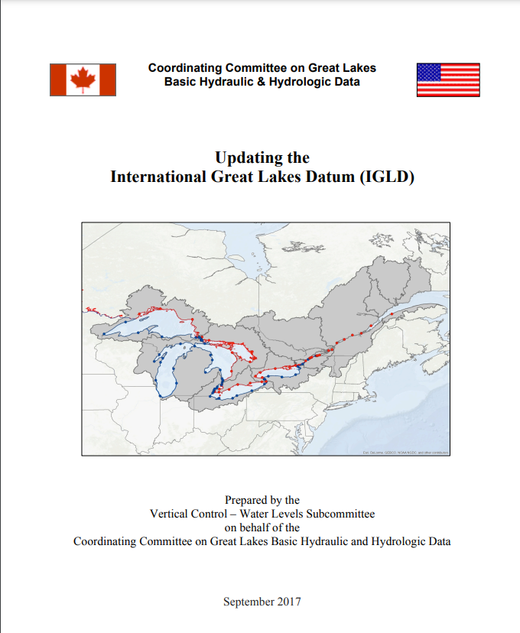
Resources
IGLD
https://www.GreatLakesCC.org/
Email: info@GreatLakesCC.org
NATRF2022 & NAPGD2022
https://geodesy.noaa.gov/datums/newdatums/index.shtml

Slide 23
Questions?
Jacob Heck, Ph.D.
jacob.heck@noaa.gov
U.S. National Geodetic Survey
National Oceanic and Atmospheric Administration
Michael Craymer, Ph.D.
michael.craymer@canada.ca
Canadian Geodetic Survey
Natural Resources Canada

Slide 24
Extra slides

Slide 25
Geopotential
h
The resting water has “potential” energy just by being high up on this cliff.
Energy = mgh
That potential energy can turn into real (kinetic) energy by falling.
Energy = ½ mv² (= mgh)
Think of the Earth as creating a “gravity field” that masses experience. I’ve drawn potential “field lines”
Potential = gh
Gravity x Height is “Geopotential”. This is what water “feels”.

Slide 26
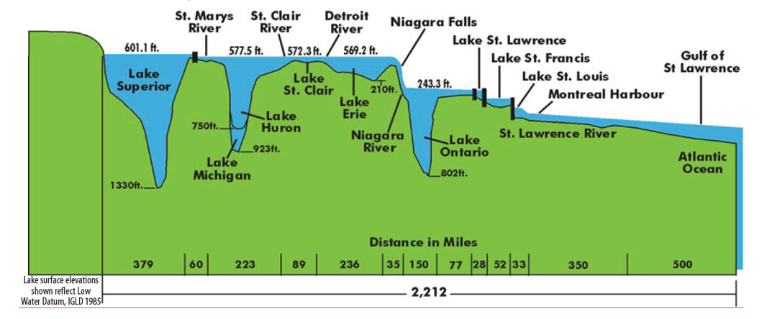
GREAT LAKES SYSTEM PROFILE
Notes:
Series of lakes (all have their own LWD)
Connecting channels have step planes set by NOAA
NOAA is charting authority for Great Lakes
USACE surveys and maintains federal navigation channels & Projects

