Slide 1
Moving To & Working In IGLD (2020)
Michael Craymer Canadian Geodetic Survey, Natural Resources Canada
Jacob Heck National Geodetic Survey, NOAA

Slide 2
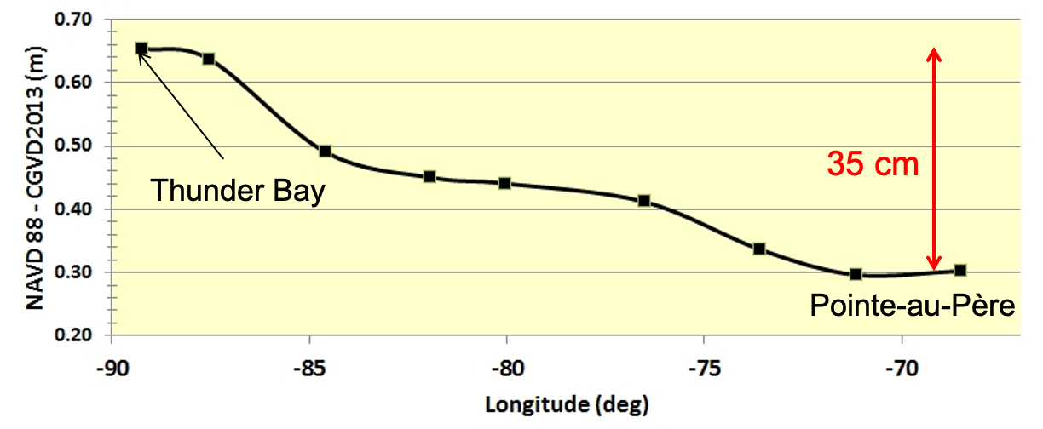
What is Changing with IGLD (2020)
The reference zero
The reference surface
Hydraulic correctors
Possibly Low Water Datum
Expected change in heights
IGLD (1985) = NAVD 88 dynamic height
IGLD (2020) ≈ CGVD2013 dynamic height
Expected change in height from IGLD (1985) to IGLD (2020) (along Canadian shoreline)
65 cm
30 cm

Slide 3
Change of Vertical Datum
Mean Water Level
Height above LWD
BM
Low Water Datum
H^{D} of LWD
H^{D} of MWL
H^{D} of BM
Vertical Datum

Slide 4
Change of Vertical Datum
Mean Water Level
Height above LWD (no change)
BM
Low Water Datum
H^{D} of LWD
(smaller)
H^{D} of MWL
(smaller)
H^{D} of BM
(smaller)
New Vertical Datum
Old Vertical Datum
Change in vertical datum

Slide 5
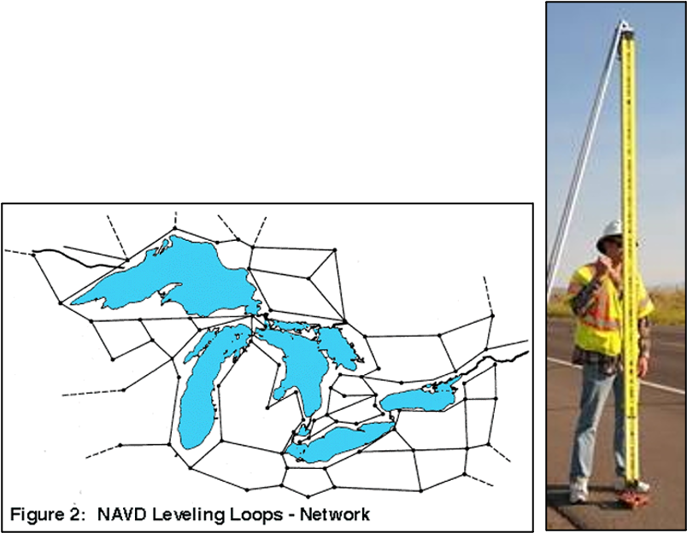
Determining Heights in IGLD (2020)
Previous IGLDs were determined by levelling
Over time, many benchmarks likely moved or were damaged
Levelling network is outdated
Relevelling the whole network is too costly and time consuming
Levelling network will be readjusted in NAPGD2022/IGLD (2020) but…
No plans to maintain the existing levelling network or its benchmarks
Primary access will be via GNSS, not levelling from benchmarks (BMs)

Slide 6
Determining Heights via GNSS
Provides direct tie to IGLD (2020) datum => highest accuracy tie
Different types of GNSS methods
Static observations - need to occupy BM for a few hours for reliable results
RTK (real-time kinematic) using a commercial RTK service that uses their own network of CORS-like stations - only need to occupy BM for a few minutes
Guidelines for using GNSS will be provided
Still need local levelling to tie gauge to GNSS BM (vertical datum)

Slide 7
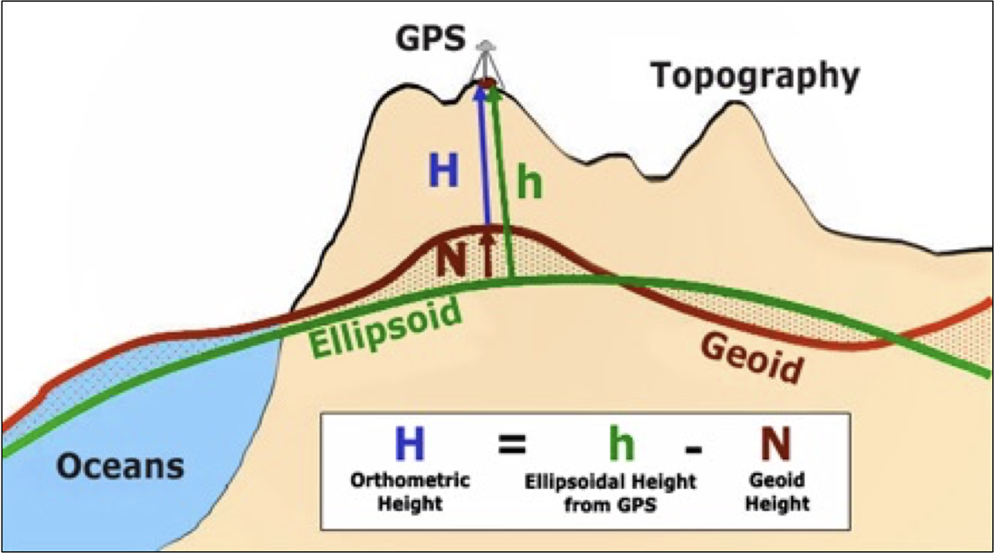
Determining Heights via GNSS
h → H → H^{D}
h = ellipsoidal height obtained from GNSS
N = geoid height obtained from geoid model (provided by CGS & NGS)
H = orthometric height
H^{D} = dynamic height obtained from H using gravity model (provided by CGS/NGS)
h & N must be referenced to the same reference ellipsoid (NATRF2022)
Online conversion tools provided by CGS & NGS

Slide 8
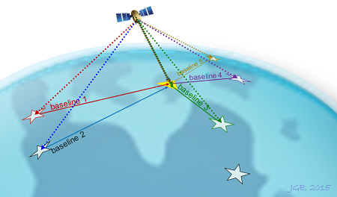
GNSS Processing Tools
Free online GNSS processing services
NRCan’s CSRS-PPP (precise point positioning service) - used world-wide - reference defined by precise orbits
NGS’s OPUS traditional baseline processing service - uses data from nearby CORS stations to tie to geometric reference frame (NAD83, NATRF2022 or ITRF?)
Online tools to be provided by NRCan & NGS for converting from GNSS ellipsoidal heights to IGLD (2020) dynamic heights
Receiver manufacturers’ software

Slide 9
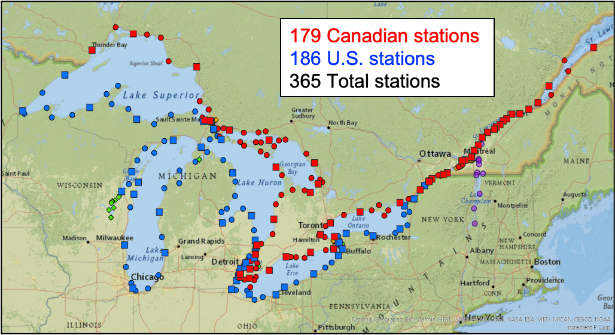
Moving Water Level Gauges to IGLD (2020)
Need to determine IGLD (2020) heights for all water level gauges
Previous GPS surveys at CHS & NOAA permanent gauges in 1997, 2005, 2010, 2015
2022 GNSS survey conducted by members of the Coordinating Committee led by CGS and NGS
Occupied GNSS BMs at most gauges on the Great Lakes, their interconnecting channels, St. Lawrence River, Richelieu River, and Lake Champlain
Permanent gauges (CHS, ECCC, NOAA, USACE, USGS, Seaway, NYPA, OPG)
Seasonal gauges for determination of hydraulic correctors
Two 24 hr occupations on each BM for highest accuracy
Presently processing data

Slide 10
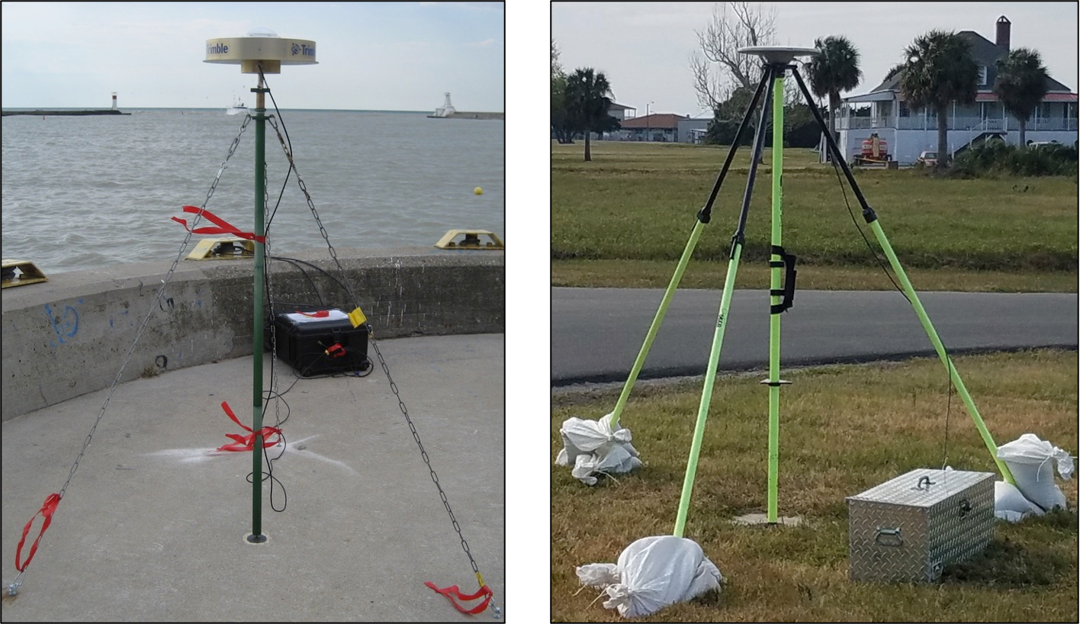
GNSS Occupations of Benchmarks
NGS Number observers: 12+USACE Duration: 6 weeks Sat observations collected: 1M+ Hours of obs: 9.6K+ Miles travelled: ~49K
Canada (CGS, CHS, ECCC) Number of observers: 12 full time Duration: 5-6 weeks Epochs collected: 1M+ Hours of obs: 9.5K+ Km travelled: ~66K
Canadian GNSS Setup
American GNSS Setup

Slide 11
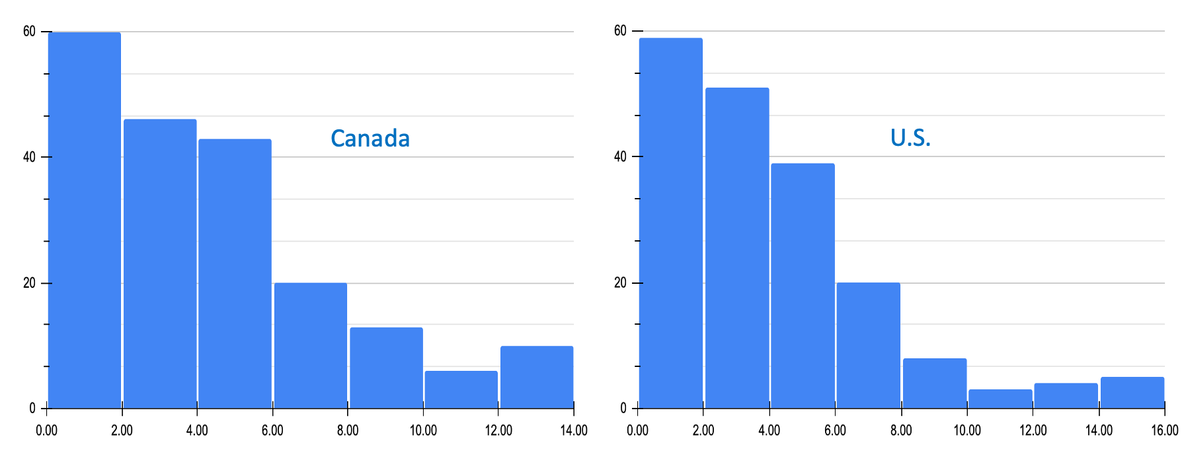
Vertical PPP Repeatability
Histograms of Vertical Repeatability (mm) Between Occupations

Slide 12
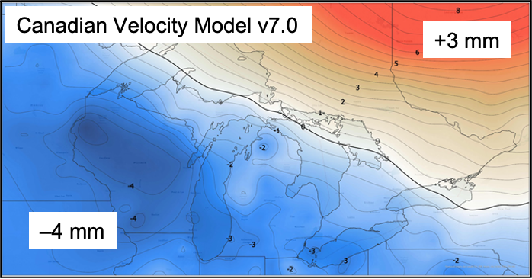
“Dynamic” Nature of IGLD (2020)
IGLD (2020) & NAPGD2022 are dynamic datums
Heights are changing in time due to regional & local crustal motions
A deformation model will be used to propagate heights to a common epoch
Estimated from a long history of GNSS positions of CACS & CORS stations
Used to account for crustal motion by propagating coordinates to a common reference epoch (i.e., 2020.0)
Deformation models (interpolation grids) Will be provided by CGS & NGS
Expected to be also incorporated into commercial software (e.g., ArcGIS)
Should be no need to update IGLD in future

Slide 13
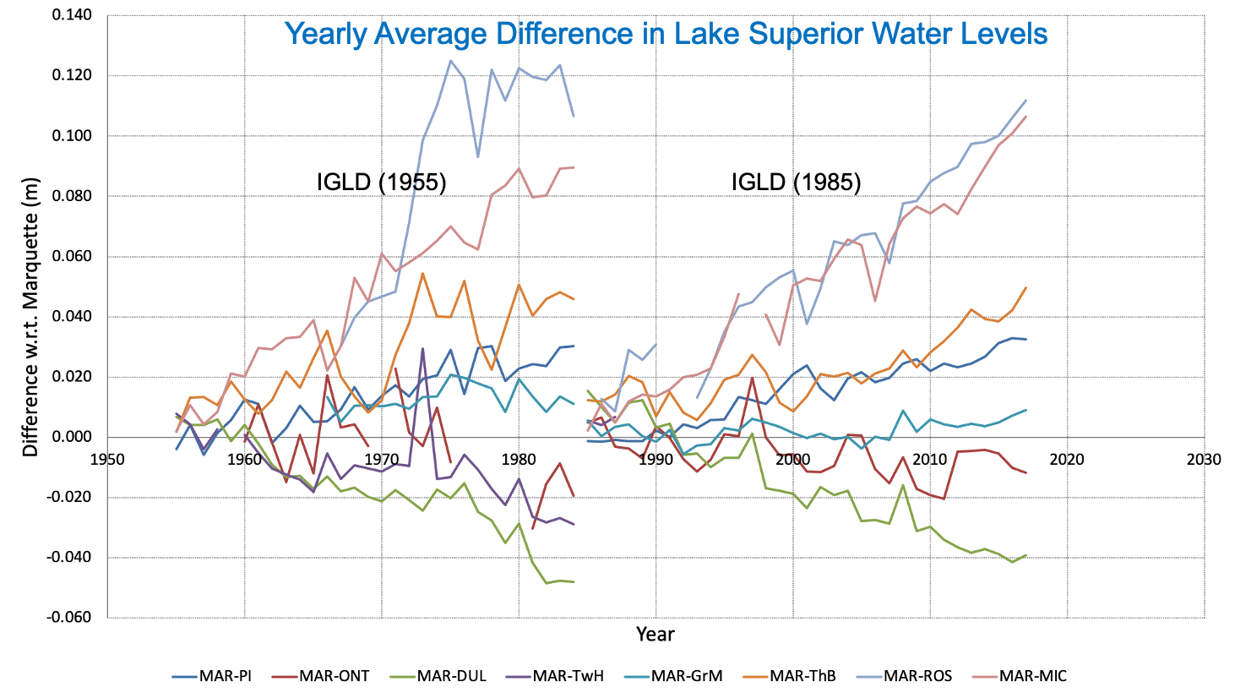
Water Levels Uncorrected for Crustal Motion

Slide 14
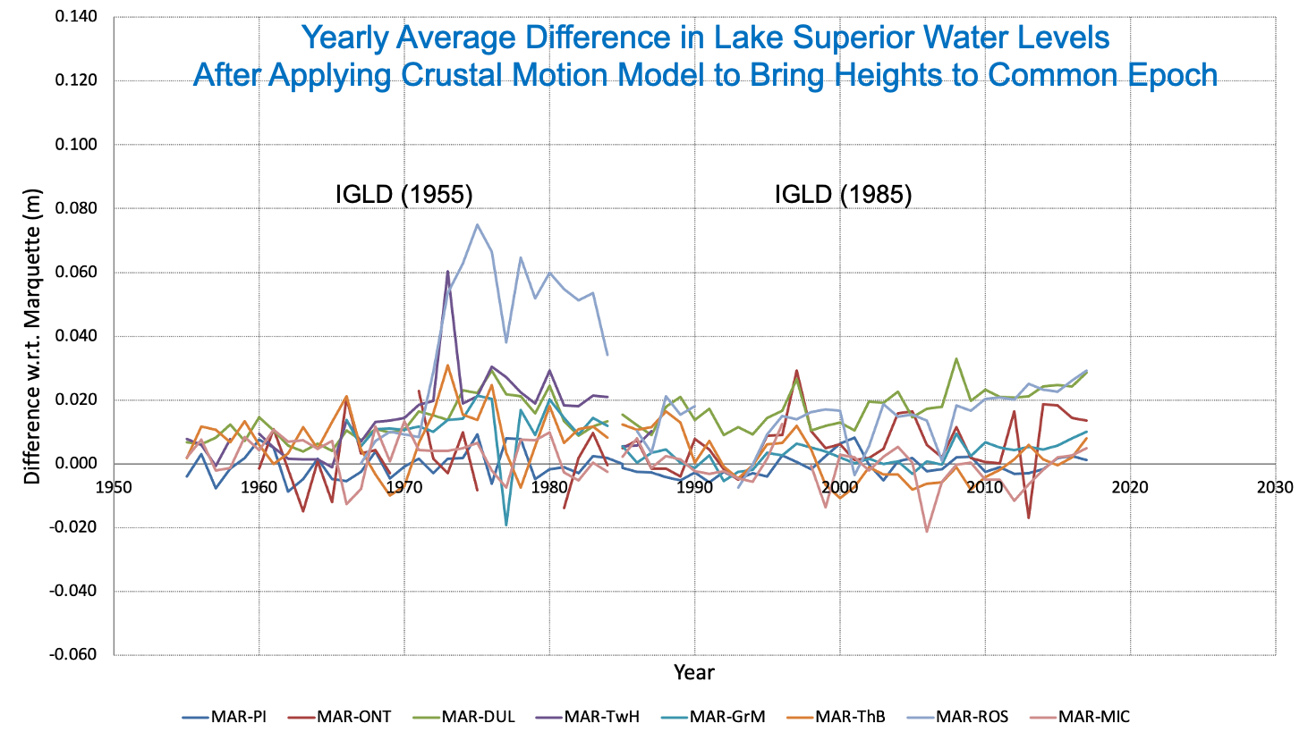
Water Levels Corrected for Crustal Motion

Slide 15
Transformations from Older Datums
Many will need to convert large amounts of data from older datums to IGLD (2020)
Transformation grids will be provided by CGS & NGS
Need heights at common points in old and new datums
Tools must be capable of transforming thousands of data points
Will use a common (binational) grid format based on international standards
Simple height offset may be sufficient for local areas, depending on distortions in older networks
Accuracy of transformations depends on
Accuracy of heights in older datums – can’t improve accuracy
Homogeneous spatial coverage of stations for better modelling of distortions in older datums
Included as many such stations as possible in the 2022 GNSS campaign

Slide 16
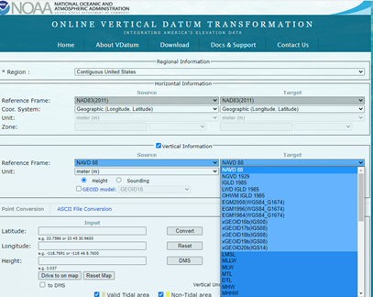
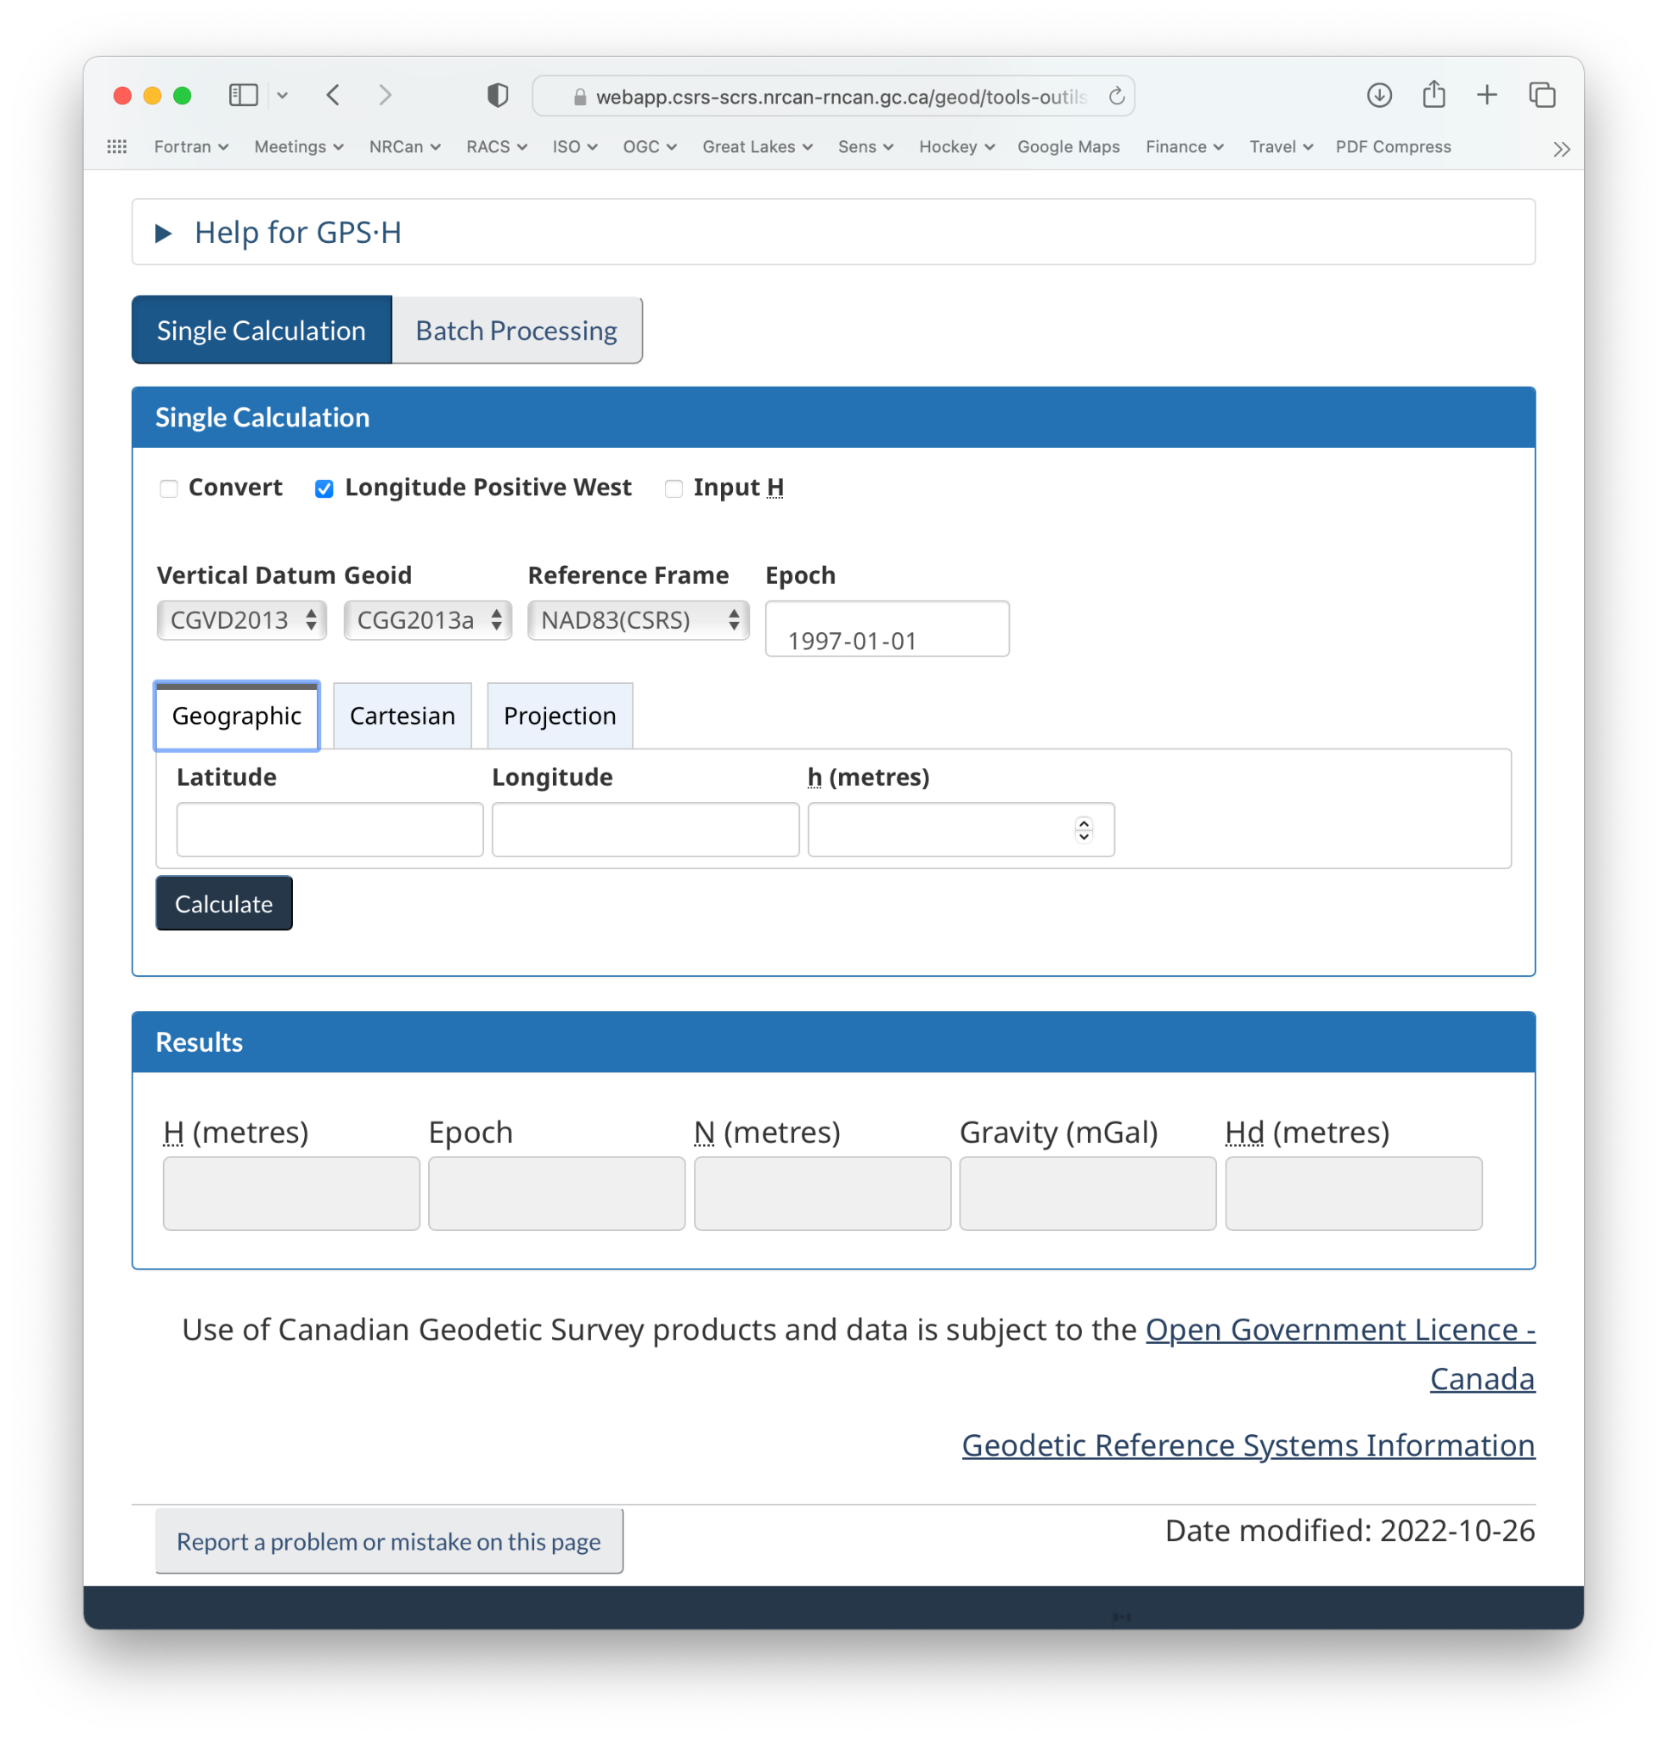
CGS/NGS Tools
Grids for NATRF/NAPGD2022 & IGLD (2020) will be provided by NOAA & NRCan
GPS-H (Canada) & VDatum (US) Software
GNSS ellipsoidal heights to orthometric & dynamic heights
Transform heights between datums
Supports batch processing of stations
Desktop applications available
REST APIs available

Slide 17
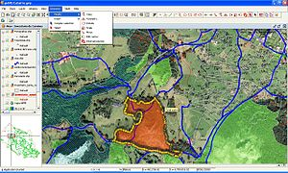
Commercial GIS Tools
Transformation grids are expected to be implemented in many GIS software
CGS & NGS working with software developers to ensure they have what they need
Geospatial Software Developers Summit
Hosted by CGS & NGS, Nov 30 – Dec 1, 2022
19 federal & provincial government participants
17 participants from 13 software companies
Commercial & open source software represented
Most developers committed to having transformation tools ready by 2025
Alpha & Beta products to be provided by CGS & NGS to help developers prepare

Slide 18
Impacts of Updating IGLD
Updating water levels to a new IGLD will have significant impacts on many operations, products and services in the Great Lakes region
Economic viability and safety of commercial and recreational navigation, including charts, ports/harbors and dredging of navigation channels
Water level regulation and forecasting
Coastal zone management and planning, including flood & erosion prediction and response, and coastal structure design, construction & maintenance
Coastal habitat restoration under the Great Lakes Restoration Initiative (GLRI)
More details provided in IGLD Update Plan on CC website
The Coordinating Committee is conducting outreach efforts like this one to inform and get feedback from stakeholders

Slide 19
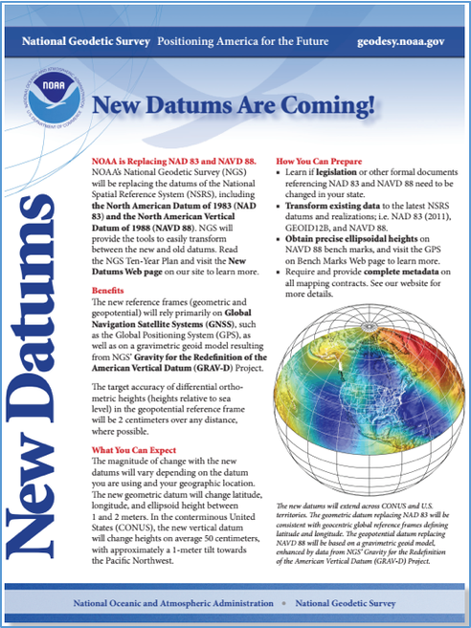
For More Information
IGLD datums
https://GreatLakesCC.org
Email: info@GreatLakesCC.org
New NAPGD2022 & NATRF2022 datums
https://geodesy.noaa.gov/datums/newdatums

Slide 20
Questions?

