Slide 1
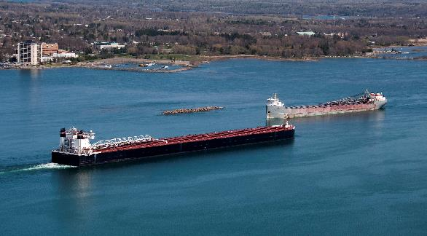
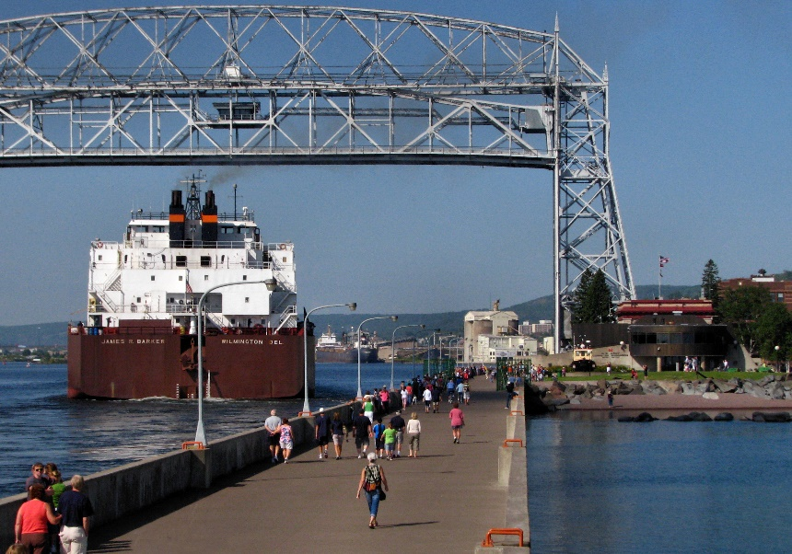
Low Water Datum Update Impacts to Great Lakes Navigation and Channel Maintenance
US Army Corps of Engineers
Esther Johnson
Assistant Chief – Operations Division
Detroit District
Cynthia Jarema
Chief – Operations Division
Detroit District

Slide 2
Federal Projects on the Great Lakes
A non-linear navigation system; 60 federal commercial projects and 80 federal shallow draft/recreational projects
Managed as a system by the Great Lakes Navigation Team comprised of Buffalo, Chicago, and Detroit District staff.
Grand Marais
Chippewa Harbor
Taconite
Lake Superior
Silver Bay
Two Harbors
Cornucopia
Eagle Harbor
Lac La Belle
Knife River
Keweenaw Waterway
Grand Traverse Bay
Duluth-Superior
La Pointe
Port Wing
Bayfield
Big Bay
Little Lake
Whitefish Point Harbor
Black River
Ontonagon
Presque Isle
Grand Marais
Soo Locks
Ashland
Saxon
MI
Marquette
St. Marys River
Manistique
Channels in Straits of Mackinac
Detour
Grays Reef
Les Cheneaux Island
CANADA
Little Bay de noc
Mackinac Island
St. James
Mackinac City
Cheboygan
Hammond Bay
Washington Island
Inland Route
Cedar River
Petoskey
WI
Menominee
Charlevoix
Lake Huron
Ogdensburg
Oconto
Sturgeon Bay
Leland
Alpena
Morristown
Pensaukee
Algoma
Greilickville
Big Suamico
Kewaunee
Frankfort
Harrisville
Green Bay
Arcadia
Au Sable Harbor
Cape Vincent
Two Rivers
Portage Lake
Tawas Bay
Ontario
Sackets Harbor
Manitowoc
Manistee
Point Lookout
Port Austin
Lake
Ludington
Harbor Beach
Port Ontario
Sheboygan
Pentwater
Caseville
Oswego
White Lake
Saginaw
Bay Port
Port Sanilac
Port Washington
MI
Sebewaing
Lexington
Little Sodus Bay
Lake Michigan
Muskegon
Niagara River
Oak Orchard
Great Sodus Bay
Little River
Irondequoit Bay
Olcott
Grand River
Black River
Wilson
Rochester
Milwaukee
Grand Haven
Pine River
St. Clair River
Buffalo
Holland
Belle River
Black Rock Lock/Tonawanda
Kenosha
Saugatuck
Clinton River
Sturgeon Point
NY
IL
Waukegan
South Haven
Lake St. Clair
Lake Erie
Cattaraugus
St. Joseph
Rouge River
Dunkirk
Commercial
St. Joseph River
Detroit River
Put-In-Bay
Barcelona
Chicago Harbor
New Buffalo
Monroe
Erie
Bolles Harbor
Conneaut
Recreational
Michigan City
Fairport
PA
Chicago River
Toledo
Ashtabula
Calumet
Burns Small Boat Harbor
OH
Cooley Canal
Rocky River
Toussaint River
Cleveland
West Harbor
Indiana Harbor
Port Clinton
Burns Waterway Harbor
Vermilion
IN
Lorain
Huron
Sandusky
Notes:
Great Lakes system is comprised of:
140 federal harbors on the great lakes: 60 commercial and 80 recreational
Connecting channels: St. Marys, Detroit River, St. Clair River, and Channels of Lake St. Clair
3 locks: Soo, Chicago, Black Rock (Buffalo)
We maintain the channels (dredging) and also maintain the navigation structures at each harbor.

Slide 3
Federal Projects on the Great Lakes
A non-linear navigation system; 60 federal commercial projects and 80 federal shallow draft/recreational projects
Managed as a system by the Great Lakes Navigation Team comprised of Buffalo, Chicago, and Detroit District staff.
Grand Marais
Chippewa Harbor
Taconite
Lake Superior
Silver Bay
Two Harbors
Cornucopia
Eagle Harbor
Lac La Belle
Knife River
Keweenaw Waterway
Grand Traverse Bay
Duluth-Superior
La Pointe
Port Wing
Bayfield
Big Bay
Little Lake
Whitefish Point Harbor
Black River
Ontonagon
Presque Isle
Grand Marais
Soo Locks
Ashland
Saxon
MI
Marquette
St. Marys River
Manistique
Channels in Straits of Mackinac
Detour
Grays Reef
Les Cheneaux Island
CANADA
Little Bay de noc
Mackinac Island
St. James
Mackinac City
Cheboygan
Hammond Bay
Washington Island
Inland Route
Cedar River
Petoskey
WI
Menominee
Charlevoix
Lake Huron
Ogdensburg
Oconto
Sturgeon Bay
Leland
Alpena
Morristown
Pensaukee
Algoma
Greilickville
Big Suamico
Kewaunee
Frankfort
Harrisville
Green Bay
Arcadia
Au Sable Harbor
Cape Vincent
Two Rivers
Portage Lake
Tawas Bay
Ontario
Sackets Harbor
Manitowoc
Manistee
Point Lookout
Port Austin
Lake
Ludington
Harbor Beach
Port Ontario
Sheboygan
Pentwater
Caseville
Oswego
White Lake
Saginaw
Bay Port
Port Sanilac
Port Washington
MI
Sebewaing
Lexington
Little Sodus Bay
Lake Michigan
Muskegon
Niagara River
Oak Orchard
Great Sodus Bay
Little River
Irondequoit Bay
Olcott
Grand River
Black River
Wilson
Rochester
Milwaukee
Grand Haven
Pine River
St. Clair River
Buffalo
Holland
Belle River
Black Rock Lock/Tonawanda
Kenosha
Saugatuck
Clinton River
Sturgeon Point
NY
IL
Waukegan
South Haven
Lake St. Clair
Lake Erie
Cattaraugus
St. Joseph
Rouge River
Dunkirk
Commercial
St. Joseph River
Detroit River
Put-In-Bay
Barcelona
Chicago Harbor
New Buffalo
Monroe
Erie
Bolles Harbor
Conneaut
Recreational
Michigan City
Fairport
PA
Chicago River
Toledo
Ashtabula
Calumet
Burns Small Boat Harbor
OH
Cooley Canal
Rocky River
Toussaint River
Cleveland
West Harbor
Indiana Harbor
Port Clinton
Burns Waterway Harbor
Vermilion
IN
Lorain
Huron
Sandusky
Notes:
Great Lakes system is comprised of:
140 federal harbors on the great lakes: 60 commercial and 80 recreational
Connecting channels: St. Marys, Detroit River, St. Clair River, and Channels of Lake St. Clair
3 locks: Soo, Chicago, Black Rock (Buffalo)
We maintain the channels (dredging) and also maintain the navigation structures at each harbor.

Slide 4
Low Water Datum - Navigation
Low Water Datum is the navigational chart datum, one for each of the Great Lakes. Different Low Water Datum surfaces are defined for each lake and the connecting channels
Depths shown on navigational charts and the authorized depths for navigation improvements are referred to Low Water Datum
USACE is responsible for operations and maintenance of the federal navigation channels including conditional surveys and maintenance dredging
Image above is USACE condition survey of Holland Harbor, MI. Red represents areas of federal navigation channel where project depth is less than authorized.

Slide 5
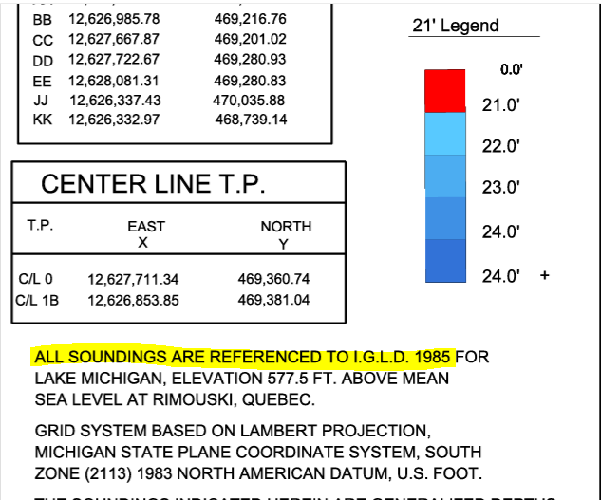
Low Water Datum - Navigation

Slide 6
Potential Change Relative to LWD
LAKE | Existing LWD | Time Below LWD | Potential Change Relative to LWD*
 | (Feet) | (1918-2017) | (Inches)
Superior | 601.10 | 40% | -9
Michigan-Huron | 577.50 | 26% | -12
St. Clair | 572.30 | 22% | -1.5
Erie | 569.20 | 11% | +3
Ontario | 243.30 | 15% | -2
* Range of potential changes in LWD based on extreme value analysis representing 90% exceedance. Final values are still being developed and reviewed.
Notes:
90% Exceedance is used because it best defines a representation of “seldom” for LWD.

Slide 7
NEW LOW WATER DATUM
Implications to Authorized Project Depth
Current Water Surface: Michigan-Huron
Current LWD
Depth below LWD is 27ft, which is equal to authorized depth (Blue on surveys)
Authorized Project Depth = 27 ft
Notes:
ESTHER
The goal is for levels to SELDOM fall below LWD. With a lower LWD, levels are expected stay at or above project depths more often.
If the 90% exceedance value is selected for the datum change, we would see, for example, a 12-inch decrease of LWD on Lakes Michigan-Huron.
For this example, at a harbor or channel with a 27’ congressionally authorized project depth, we’d be seeing a new authorized depth of 26’ (12 inches less than current LWD).
LWD is for suitability of charting and dredging.
Next we’ll see how the new LWD might look on a condition survey.

Slide 8
NEW LOW WATER DATUM
Implications to Authorized Project Depth
Current Water Surface: Michigan-Huron
Current LWD
*New LWD:
12-in lower (90% exc)
Depth below LWD is 27ft, which is equal to authorized depth (Blue on surveys)
With new datum, depth below new LWD is 26ft, which is less than authorized (Red on surveys)
Authorized Project Depth = 27 ft
Notes:
ESTHER
Key concept to understand: If tomorrow LWD is updated and shifts 12” lower, that doesn’t mean the water levels and available navigation depth is all the sudden the next day dropped, its not the water levels that are changing but the reference.

Slide 9
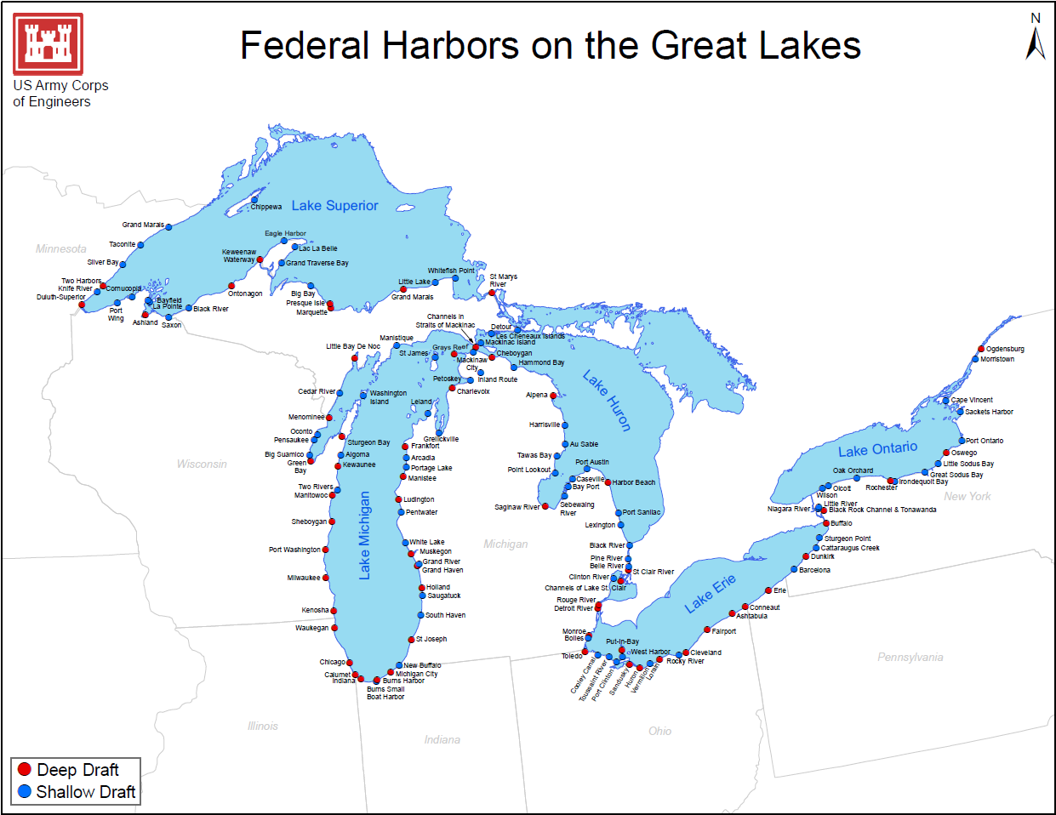
Projected Change in LWD
-9”
-12”
-2”
-12”
+3”
Notes:
- The next examples will highlight the harbors and ports that will see the largest potential impacts to a change in Lower Water Datum because they are located on Lake Superior (lowering -9.0” of LWD) and Lake Michigan (lowering -12.0” of LWD). From Missy’s presentation we see that there will be impacts on the lower lakes of Erie and Ontario, but for those harbors they are going to see an increase in LWD and therefore won’t have accumulation of shoal volume.
- Volumes of increase are approximate based on current estimate of LWD changes, which has a potential to change as Coordinating Committee gets closer to finalize LWD updates and methodology that will be used

Slide 10
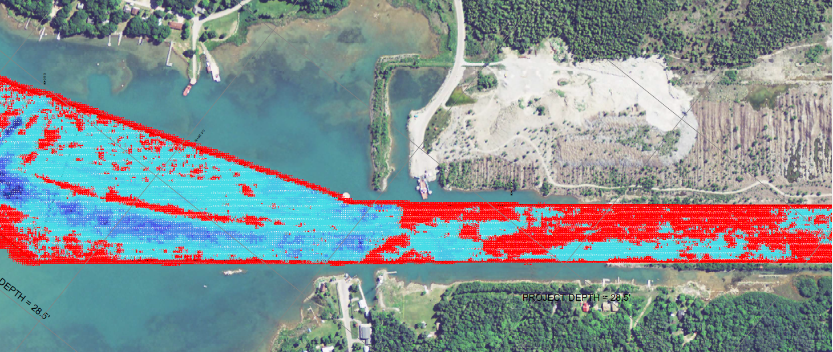
ST. MARYS RIVER – SAULT STE MARIE, MI
Current Functional Channel Backlog:
752,900 cyds
Volume Material between Existing LWD and
New LWD:
759,700 cyds
Total Material to New LWD:
1,512,600 cyds
Notes:
Costly removal of hard bottom channel material; deficit of established placement sites with capacity
Current LWD
Future LWD
Notes:
ESTHER

Slide 11
INDIANA HARBOR, IN
Current Functional Channel Backlog:
78,400 cyds
Volume Material between Existing LWD and New LWD (functional):
57,600 cyds
Total Material to New LWD:
136,000 cyds
Notes:
Potential risk of TSCA material; No placement concerns – capacity of DMDF can accommodate
Current LWD
Future LWD
Notes:
Presenter: Jeff M
NOTE: volumes are based on Spring 2022 Condition Surveys

Slide 12
 | Material Between CURRENT LWD > NEW LWD FUNCTIONAL Project Dimensions (cyds) | Material Between CURRENT LWD > NEW LWD AUTHORIZED Project Dimensions (cyds) | GROSS ESTIMATED COSTS (costs relative to FUNCTIONAL Project Dimensions)* | NUMBER OF PROJECTS CAPTURED
SUMMARY CALCULATED (Incl. Superior, Mich-Huron, Connecting Channels) | 5.8M – 6.5M | 8.5M – 9.3M | $365M - $400M | 110
DEEP DRAFT PROJECTS | 4.8 – 5.4M | 7.5M-8.0M | $300M - $315M | 43
DEEP DRAFT PROJECTS (Active Commercial) | 4.2M – 4.6M | 5.2M – 5.8M | $210M - $240M | 37
SHALLOW DRAFT PROJECTS | 1.0 – 1.1M | 1.0 – 1.1M | $65M - $70M | 67
About 35 % of projects have been identified with risks due to sediment characteristics or challenges with material below existing channel depth (ex: materials with contaminants; capping/remediation, hard bottom material, TSCA, anthropogenetic material)
Nearly 50% projects have been identified with challenges relative to dredged material management including placement availability and capacity (ex: CDF capacity, environmental compliance, placement identification)
* Escalated to FY29 costs based on anticipating budget development in FY25 (full work package cost)
Notes:
ESTHER
BLUF Here are our totals and summary of the system impacts
DISCUSSION:
Gross estimated costs are just represent cost of functional material due to LWD updates; authorized would be magnitudes more
TOTAL vs DEEP: Just over 80% of the qty of material and costs are contributable to the DEEP draft harbor (commercial harbors)
ACTIVE Commercial: 98% of material is coming from deep draft authorized projects with active commercial usage and users
Sediment Challenges: 40 of the 110 projects have some risk based on history of the project site and historical sediment data
Placement: 53 of the 110 projects will be expected to have challenges with dredge material placement

Slide 13
USACE - NEXT STEPS
Continue to inform stakeholders on IGLD2020 & LWD change. New LWD expected to be in place by 2027.
Move forward engaging with stakeholders on project-by-project basis with survey results to discuss prioritizing new LWD material removal areas.
Need detailed input from ports and users on priority areas within the projects, and feedback on prioritization within the GL Nav system
Can begin immediately discussing placement challenges and solutions
Continue refinement in calculated quantities and costs expected due to new LWD, incorporate risks related to sediment characteristics (contaminated areas, hard material or bedrock) and placement (material management, capacity, suitability).
Develop recommended phased approach for budgeting, taking into consideration material management. Layout funding strategy within typical 2-year budget cycle. Communicate both internally within Corps and externally with stakeholders on funding needs.

Slide 14
Presenters:
Joffrey Dufour & Jennifer Marche

Slide 15
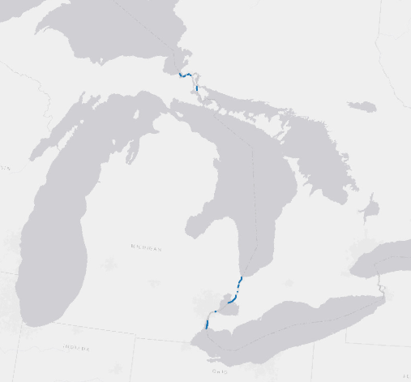
Proposed Chart Datum Shift
Superior
Proposed shift: -0.23 m
Maintained depth area managed by the CCG Central Region
Map with change colour coded
CCG area
St.Mary’s river
Shift considered: -0.30 m
Precise shift in area managed by the CCG is not determined
Precise shift in area will have to be determined by a model which has not been completed at this time
A positive shift of the datum will have no impact on dredging and may reduce the infill volume
Huron
Proposed shift: -0.30 m
Michigan
Proposed shift: -0.30 m
St.Clair
Proposed shift: -0.05 m
CCG area
St.Clair river
Shift considered: -0.05 m to -0.20 m
CCG area
Detroit river
Shift considered: 0.00 m
Erie
Proposed shift: +0.07 m
Notes:
Preliminary values released by the coordinating committee show there will be little change to the LWD in the south for areas of St. Clair River and Detroit River, but may impact St. Mary’s river by up to 0.30cm.

Slide 16
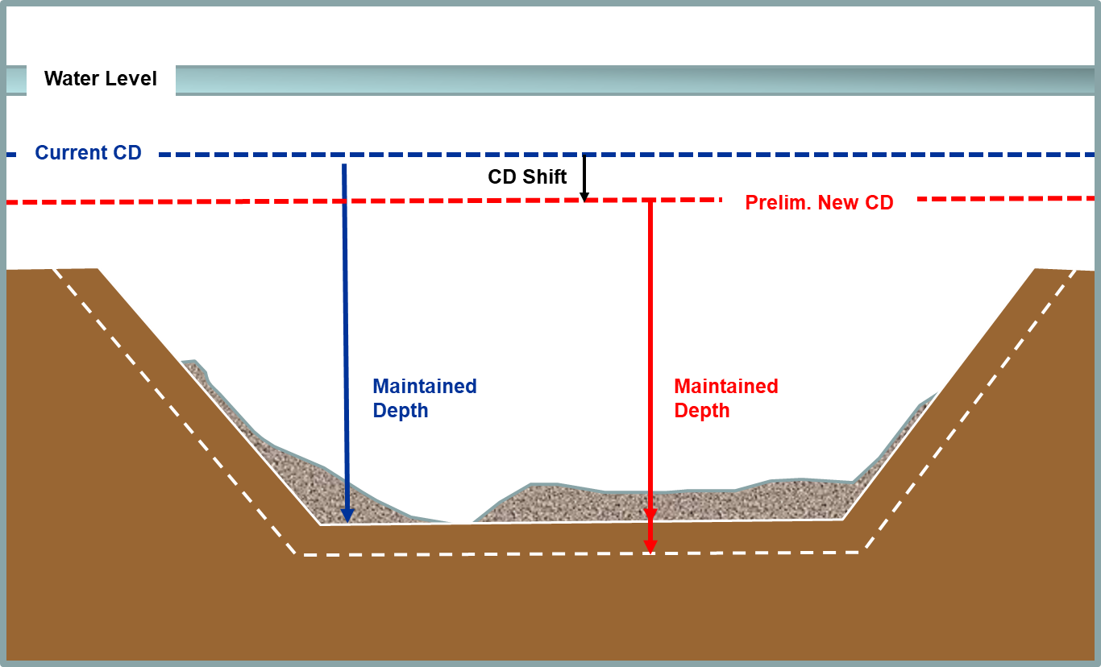
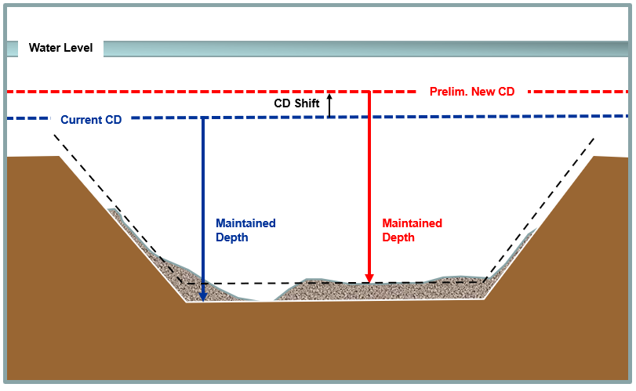
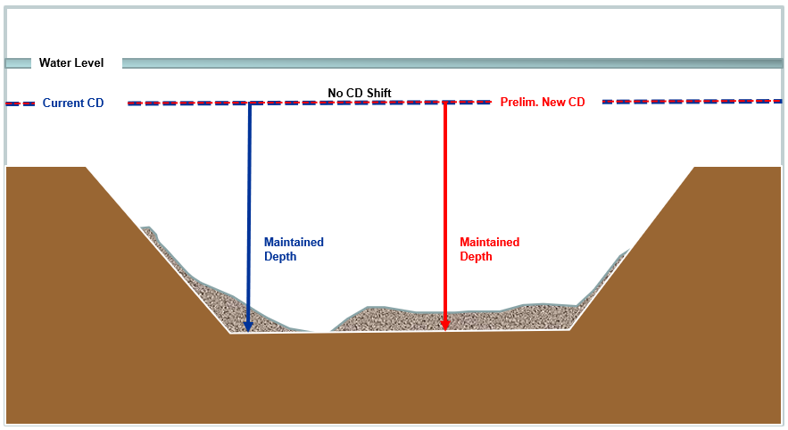
Impacts CD Changes on Waterways Program In Canada
CD is lowered
CD is shifted upward or no change
CD is shifted upward
Dredging to maintain depth
St. Mary’s River by 0.30 m (12’’)
St. Clair River between 0.05 m (2’’) and 0.20 m (8’’)
No changes to CD
Detroit River

Slide 17
Chart Datum is Lowered
To keep the same maintained depth, channels will have to be deepened by dredging.
If adopted, the charted soundings will change, but the channel’s advertised maintained depth will remain the same.
Maintained Depth at 8.3 m will remain the same
Sounding outside the channel will drop proportionally to the datum shift

Slide 18
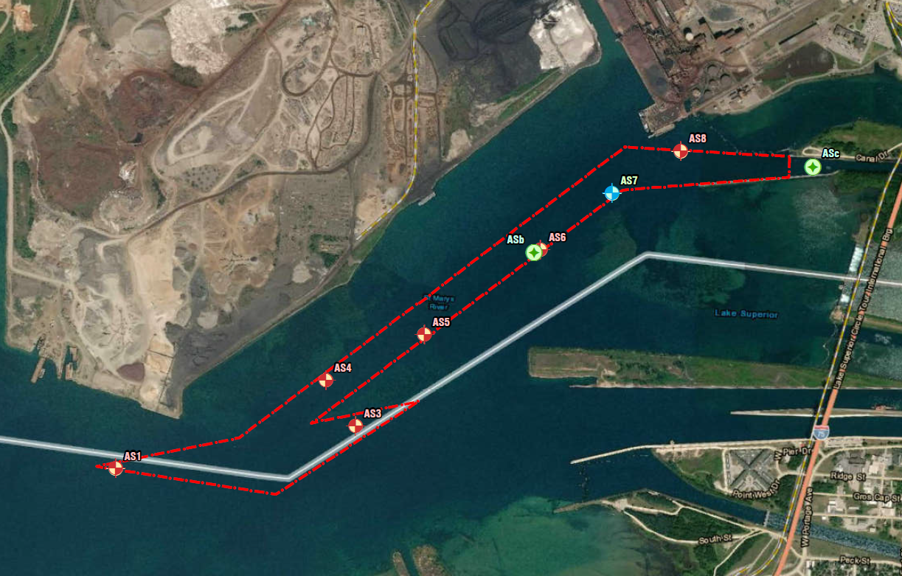
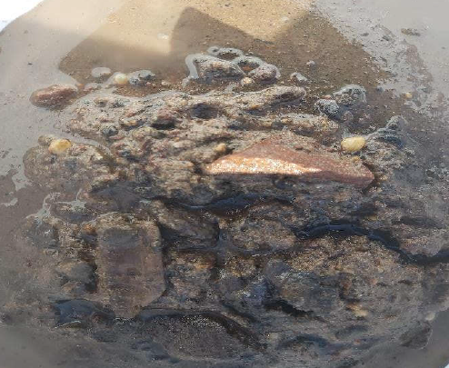
Chart Datum is Lowered
Dredging backlog plus dredging to maintained depth
Adding to existing challenges:
Material management issues
disposal of contaminated material
Resource management challenges
limited on contractors and in-water work time frame
Long term project planning difficulties
Increased cost
Increased CDF space
Other considerations:
Environmental impact
Fish habitat restrictions
Feasibility assessments
Potential need for blasting in hard bottom areas
2020 sampling location
Vidal shoal
St. Mary’s river
Extensive sampling program to be carried out as a part of the feasibility assessments

Slide 19
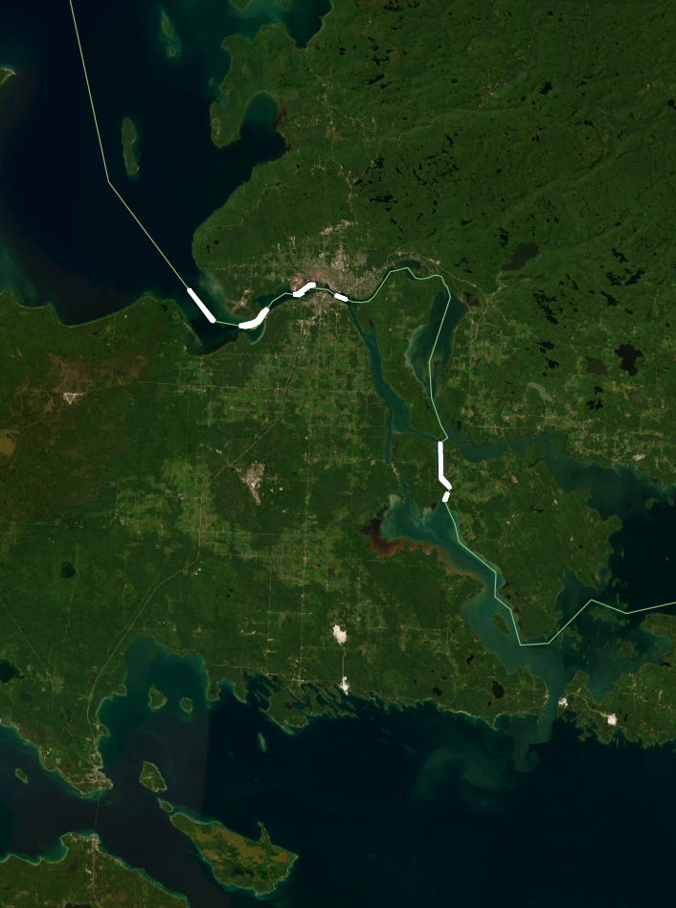
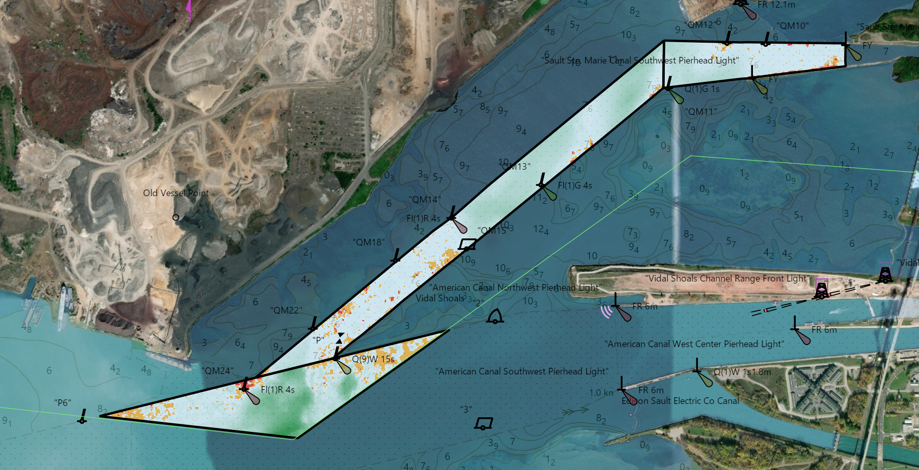
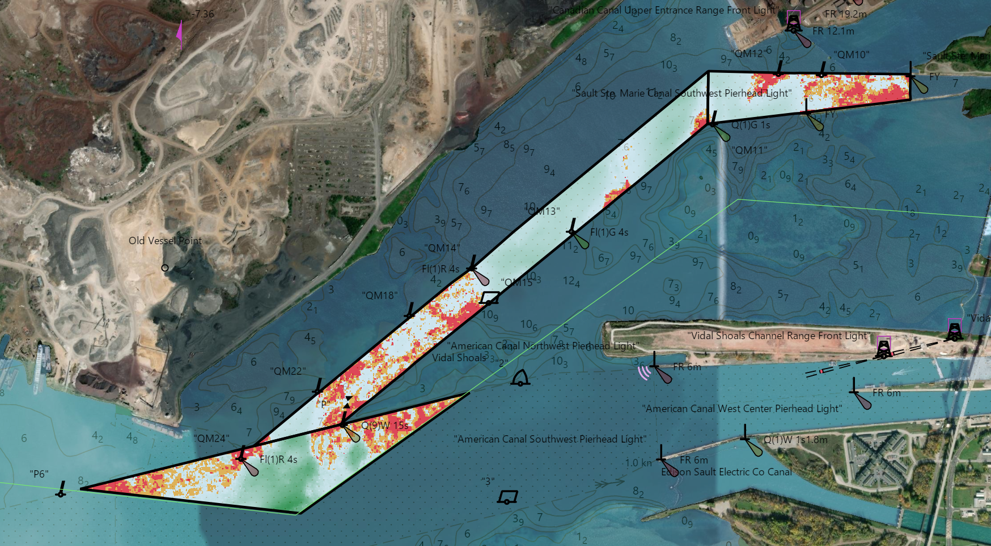
Current Situation in St. Mary’s River
Lake Superior
Enlargement
Vidal channel
Area | Current Volume Backlog (m³) | Backlog after Preliminary CD change (m³)
St. Mary’s River | 33,000 | 65,000
See enlargement
Volume are calculated without slopes and without overdredge
Proposed datum changes:
Between -0.30 m
Current CD
Lake Huron
Other considerations:
Contaminated area
Potential hard bottom area
Short working period
With CD adjustment
J

Slide 20
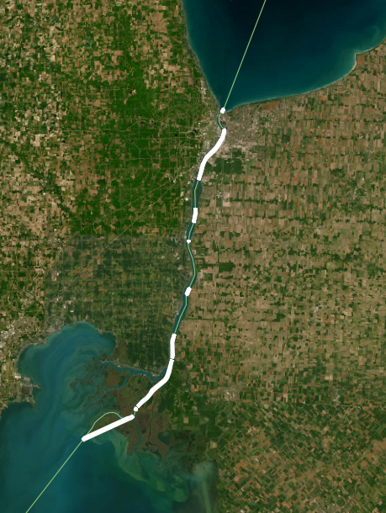
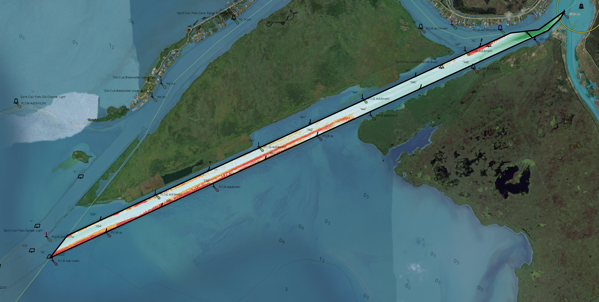
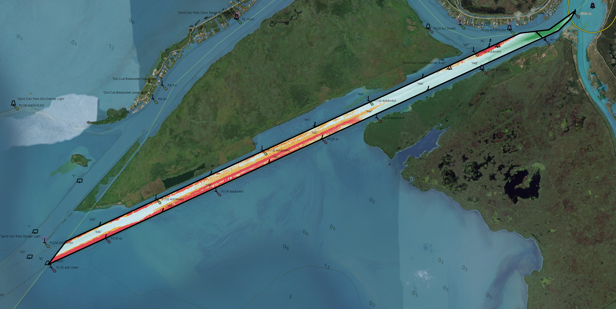
Current Situation in St. Clair River
Lake Huron
Enlargement
South East Bend Cut-off channel
Area | Current Volume Backlog (m³) | Backlog after Preliminary CD change (m³)
St. Clair River | 75,000 | +100,000
Volume are calculated without slopes and without overdredge
St.Clair river
Proposed datum changes:
Between -0.05 m and -0.20 m
Current CD
See enlargement
Lake St.Clair
Other considerations:
Contaminated area
Silty area
Disposal very expensive
With CD adjustment
J

Slide 21
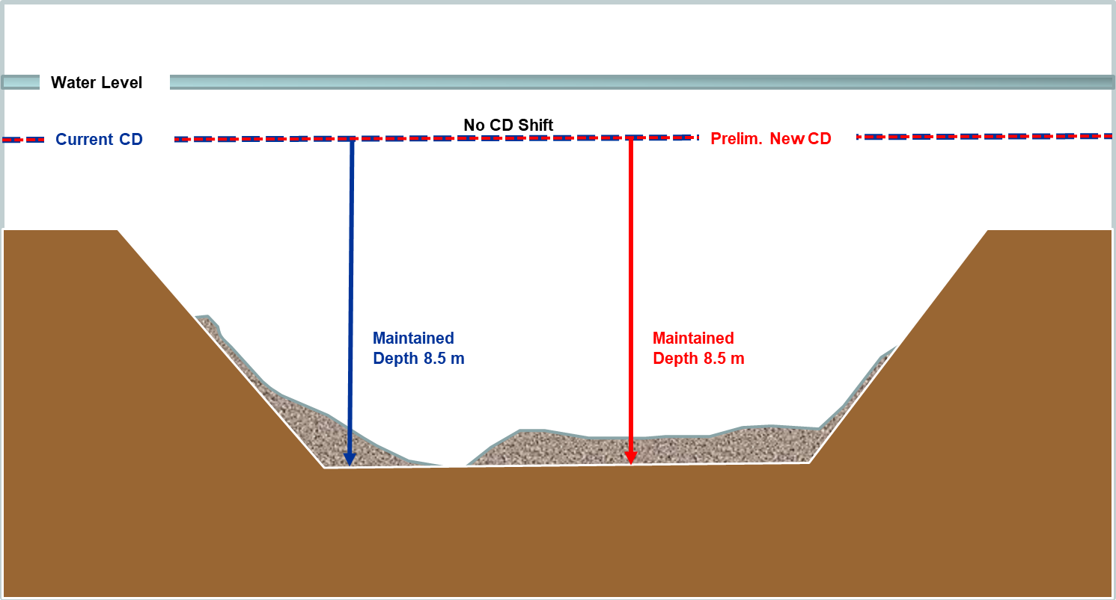
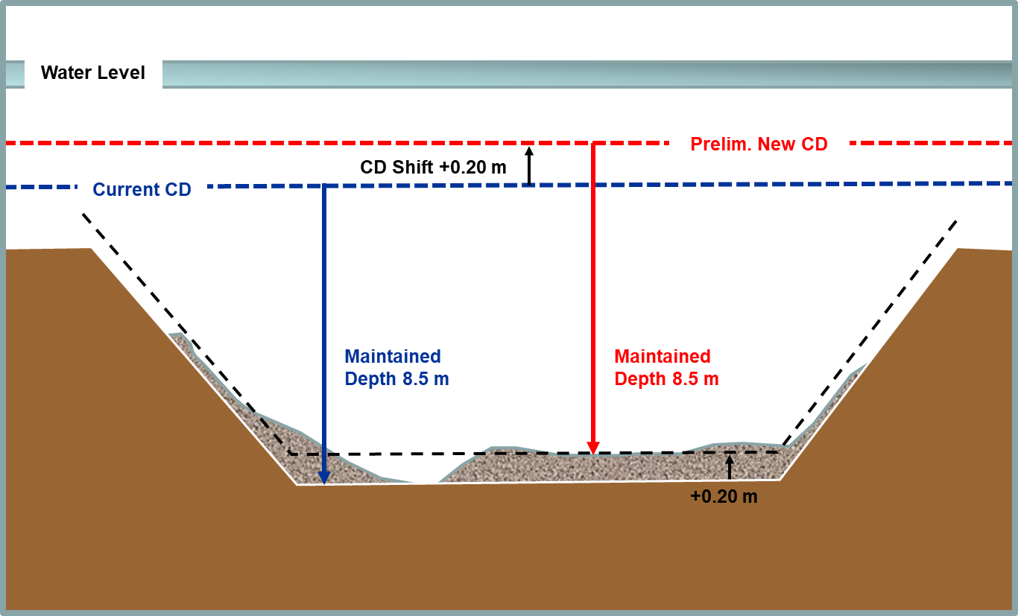
Chart Datum is risen/has no change
A complete picture of the proposed changes has yet to be established.
Continue to work on existing challenges
CCG Waterways will continue with the modernization of the “Guidelines for the Safe Design and Use of Shipping Channels” for target vessels
J

Slide 22
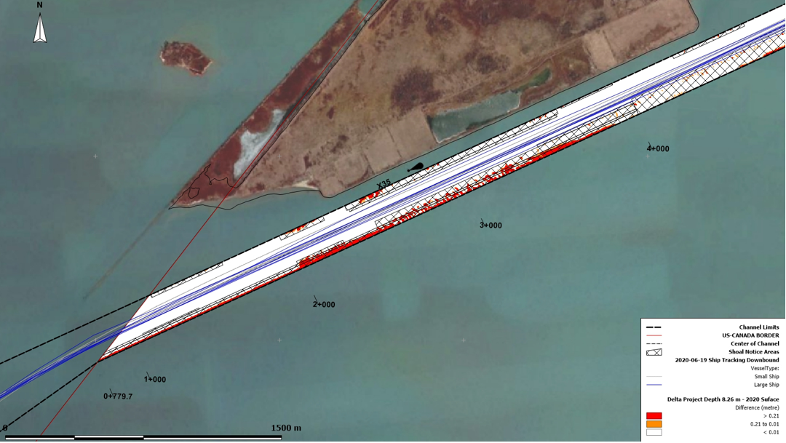
Going Forward
Looking eventually to consult for getting feedback on prioritization of dredging based on pilotage needs
Continue to work on developing sediment disposal options
Continue to work on finalizing dredging volumes and costs as well as increase sampling to understand the needs in different areas as it relates to changes in the chart datum
AIS analysis in the St.Clair River

Slide 23
Questions?
Canadian Coast Guard, Waterways
DFO.WaterwaysManagement-GestionVoiesNavigables.MPO@dfo-mpo.gc.ca
Canadian Coast Guard Waterways - Central Region
Joffrey Dufour – Joffrey.Dufour@dfo-mpo.gc.ca
Jennifer Marche – Jennifer.Marche@dfo-mpo.gc.ca
Waterways Management webpage: https://navigation-electronique.canada.ca/topics/waterways-management/index-en
Cynthia Jarema
Chief – Operations Division
Detroit District
313-226-6127
Great Lakes Navigation Webpage: https://www.lre.usace.army.mil/missions/great-lakes-navigation/

