Slide 1
UPDATING LOW WATER DATUM IN THE GREAT LAKES
Chris Zervas¹, Derrick Beach², Laura Rear McLaughlin¹, Terese Herron³
¹ Center for Operational Oceanographic Products and Services, NOAA, USA
² Meteorological Service of Canada, Environment and Climate Change Canada, Canada
³ Canadian Hydrographic Service, Department of Fisheries and Oceans, Canada
April 6, 2023

Slide 2
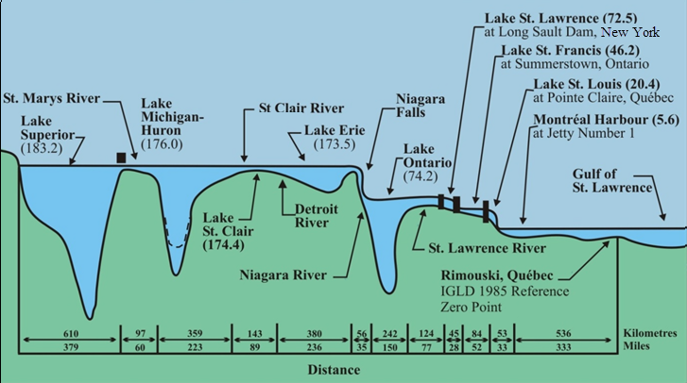
What is the Low Water Datum (LWD)?
LWD is the navigational chart datum, one for each of the Great Lakes and Lake St. Clair
Depths for harbor improvement authorizations are also referred to LWD
It is defined only as a lake-wide surface “so low that the water level will seldom fall below it”
Different LWD surfaces defined for each lake & the connecting channels

Slide 3
Low Water Datum Established in 1933
Standard Low Water (1901) was in use by the US Lake Survey as the chart datum, but no datum had been officially established for dredging and harbor improvements. Reference levels about a foot higher than the chart datum were being used in practice.
From Moore 1939, Datum planes on the Great Lakes“: It seemed desirable that a single datum plane for each lake should be adopted for use both by the Lake Survey and for improvement work. .... It seemed to be common opinion that use of what might be considered average low water was preferable to the use of extreme low water. The elevations finally decided upon were largely a compromise.“
Each lakes’ LWD was defined relative to a specified bench mark at a single ‘master’ station which were Oswego, Cleveland, Harbor Beach, and Point Iroquois. By the use of pre-existing level surveys, their elevations were assigned relative to the Mean Tide at New York City.
The International Great Lakes Datums (IGLD) of 1955 and 1985 retained the same LWDs, while relating their elevations relative to Mean Sea Level at the mouth of the St. Lawrence River.

Slide 4
Why Update the LWD Now?
Opportunity in conjunction with the IGLD 2020 update
Current LWD was established using pre-1930s data
100+ year period of lake-wide averages available from established gauge networks on each lake including Lake St. Clair
Water diversions, channel modification and erosion, outflow regulations, and climate change effects may all have changed the likelihood of occurrence of extreme low water periods in each lake

Slide 5
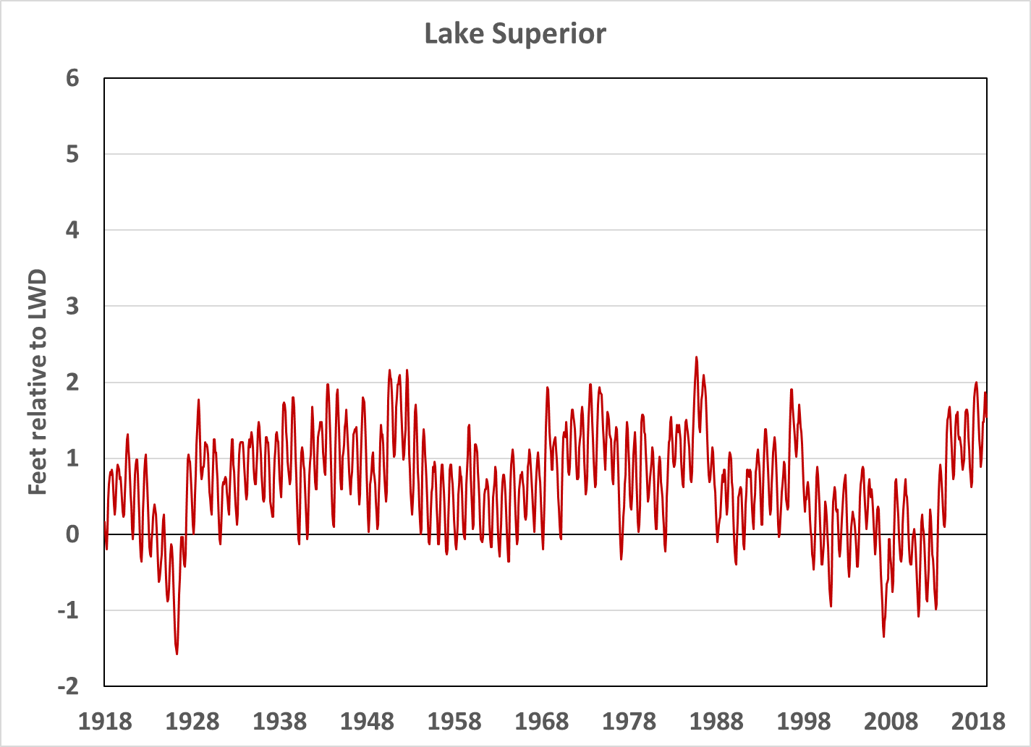
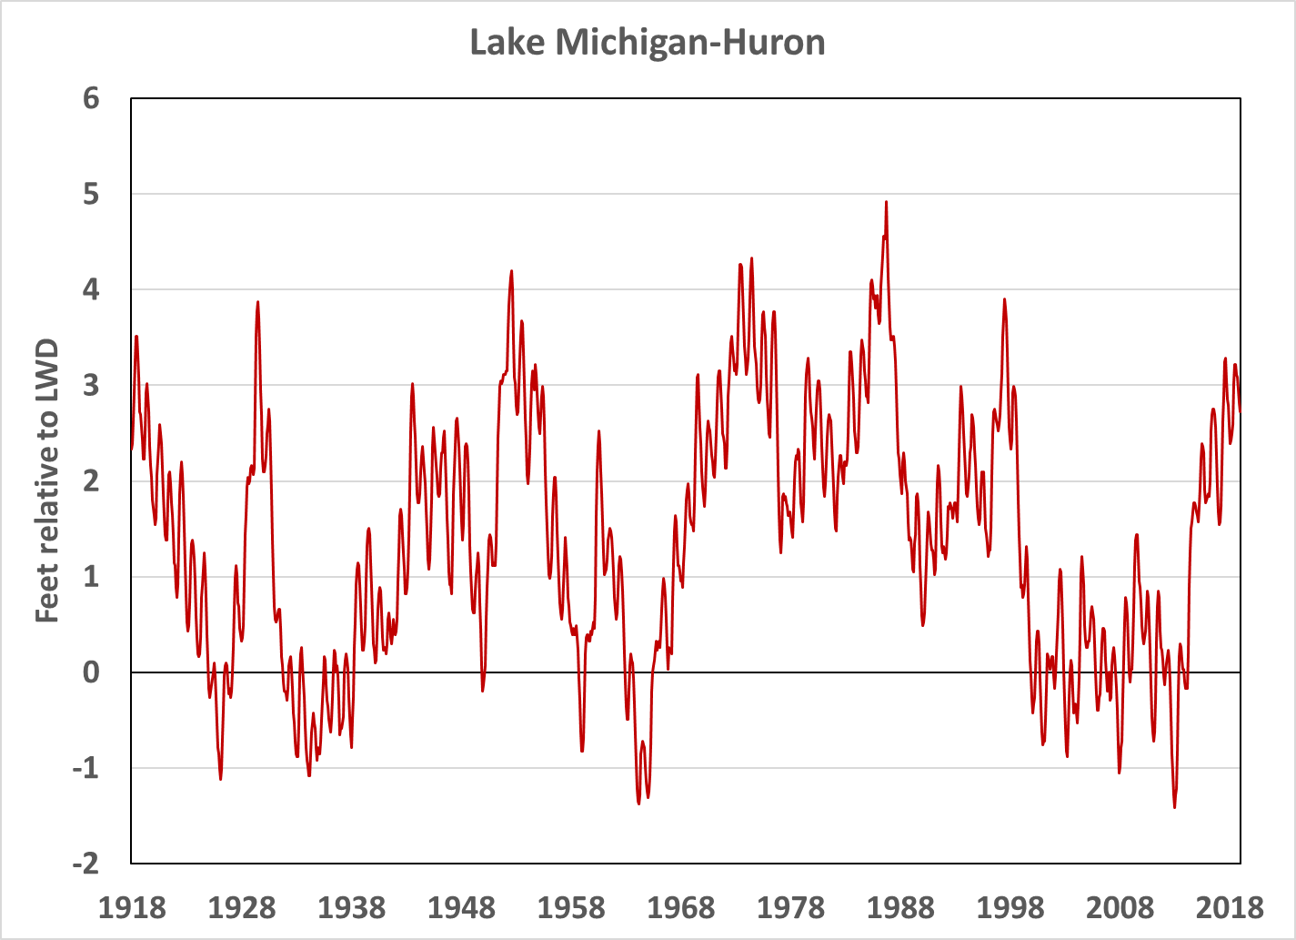
185 months below LWD (15.4%)
42 of 100 years
186 months below LWD (15.5%)
28 of 100 years

Slide 6
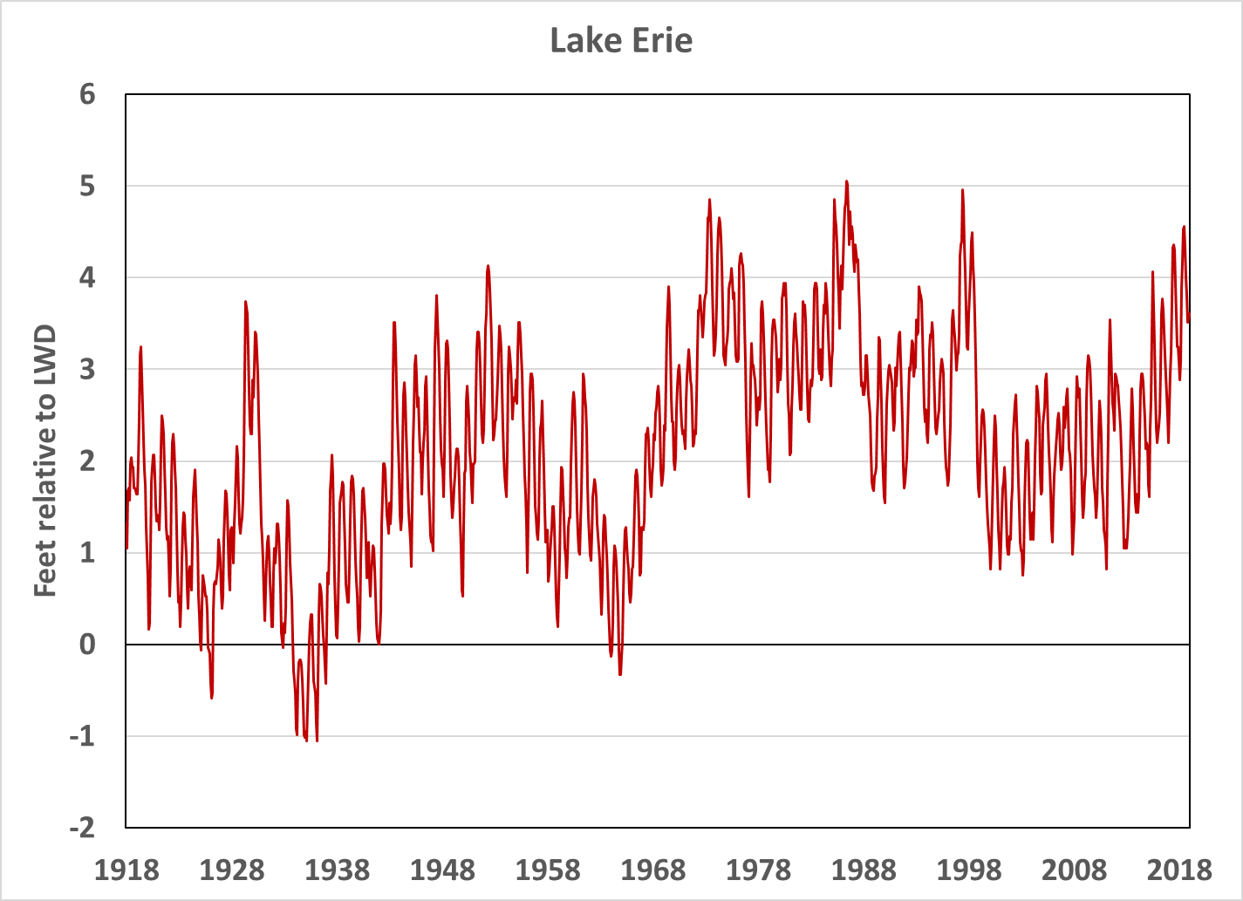
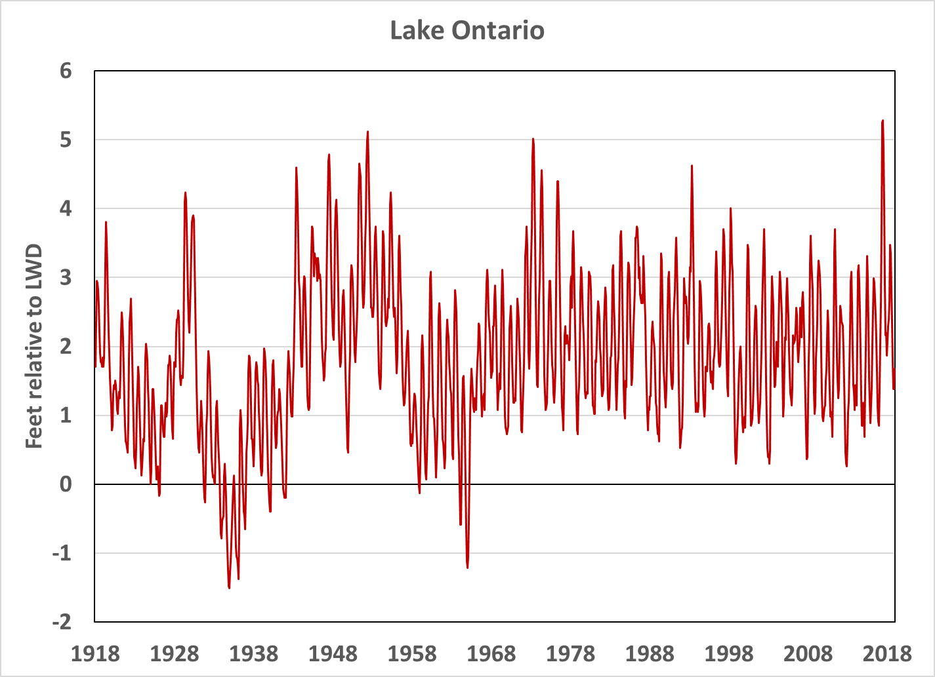
43 months below LWD (3.6%)
in 9 of 100 years; none since 1965
54 months below LWD (4.5%)
in 11 of 100 years; none since 1965

Slide 7
CALCULATION OF EXCEEDANCE PROBABILITY LEVELS
Two sets of lake-wide average data considered
100 years of historical monthly mean lake levels for Superior, Michigan-Huron, St. Clair, Erie, and Ontario (1918-2018)
100 years of monthly mean lake levels obtained from the Coordinated Great Lakes Regulation and Routing Model (CGLRRM) for Superior, Michigan-Huron, St. Clair, and Erie and 90 years for Ontario (1918-2008)
The CGLRRM model was run with the present-day channel configurations and routing regulations applied to the historic net basin supply records.
Generalized Extreme Value Analysis completed
Evaluates the probability of low water occurring in any given year

Slide 8
Results of Extreme Value Analysis
Lake | 85% Exceedance Level |  | 90% Exceedance Level |  | 95% Exceedance Level
 | Relative to LWD |  | Relative to LWD |  | Relative to LWD
Superior | -20 cm (-8 in) to -15 cm (-6 in) |  | -24 cm (-9 in) to -20 cm (-8 in) |  | -29 cm (-11 in) to -27 cm (-11 in)
Michigan-Huron | -22 cm (-9 in) to -13 cm (-5 in) |  | -30 cm (-12 in) to -20 cm (-8 in) |  | -40 cm (-16 in) to -30 cm (-12 in)
St. Clair | -11 cm (-4 in) to +3 cm (+1 in) |  | -20 cm (-8 in) to -4 cm (-2 in) |  | -33 cm (-13 in) to -14 cm (-6 in)
Erie | +7 cm (+3 in) to +15 cm (+6 in) |  | -1 cm (0 in) to +8 cm (+ 3 in) |  | -12 cm (-5 in) to 0 cm
Ontario | 0 cm to + 4 cm (+2 in) |  | -7 cm (-3 in) to -4 cm (-2 in) |  | -18 cm (-7 in) to -17 cm (-7 in)

Slide 9
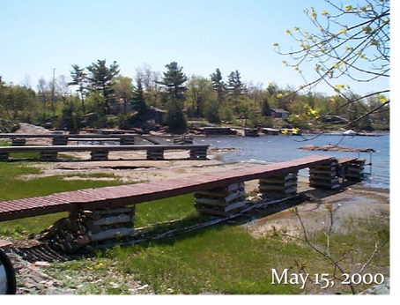
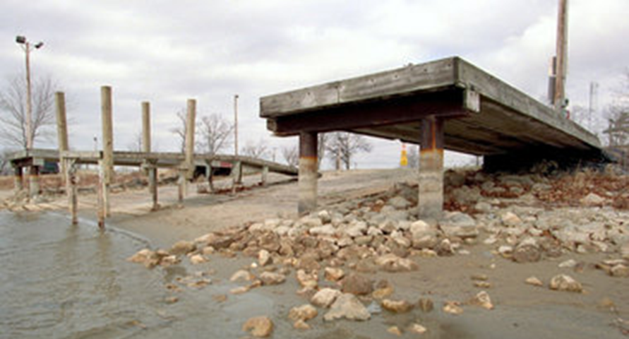
Thank you! Chris.Zervas@noaa.gov Laura.Rear.McLaughlin@noaa.gov
Derrick.Beach@ec.gc.ca
Terese.Herron@dfo-mpo.gc.ca
Maceys Bay, Ontario
Muskegeon, Michigan

